Slide 1

IMS
Kingsley Ugonna Aguagwa
January
2025

Slide 2

Table of Content
Overview of the Modular/Component Architecture
Technologies Used and Justifications
Code Highlights
Conclusion

Slide 3

Overview of the Modular/Component Architecture
The design employs a modular/component-based architecture, as described in CWK1. This architecture ensures a clear separation of concerns, making the system scalable and manageable. The system includes the following major modules:
Database Layer: Manages all database interactions, such as connections, queries, and data retrieval. This layer provides data consistency and serves as the application's backbone.

Slide 4

Overview of the Modular/Component Architecture
Backend Logic: Built with PHP, this layer handles user requests, implements business logic, and interacts with the database. It is broken down into smaller, reusable components that manage features such as viewing radiological findings, managing submitted photos, and handling patient records.
Frontend Layer: Created using HTML, CSS (Bootstrap), and JavaScript, this layer provides an intuitive and user-friendly experience to end users.

Slide 5
Utility Components: Contains common reusable components such as navbar.php and sidebar.php to provide consistency across all pages.
Traceability from design to code is maintained by aligning modules with architecture-defined functionalities. For example, the file view_radiology_result.php relates to the design's radiology result management module.

Slide 6
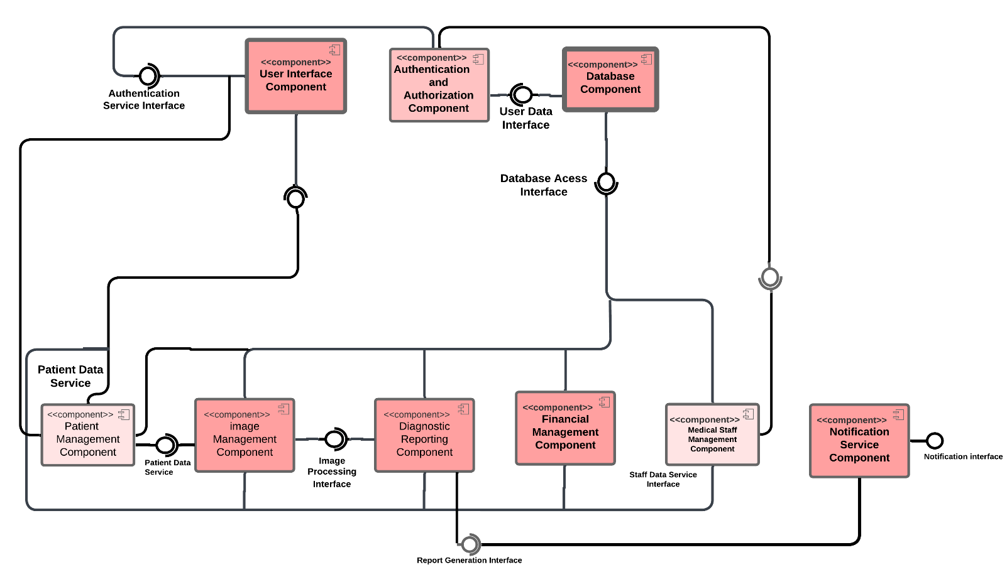
Figure 1.1: Component Diagram of IMS (CWK1)
Traceability from design to code is maintained by aligning modules with architecture-defined functionalities. For example, the file image management component (view_radiologist_result.php) relates to the design's patient management component (view_patient.php).

Slide 7
Technology Used and Justifications
Backend Technology: PHP
Reason: PHP was chosen for its simplicity, broad use, and interoperability with a variety of database systems, including MySQL.
Features Utilised:
Strong support for database interfaces via PDO for secure and prepared statements.
Excellent compatibility with the XAMPP development environment.

Slide 8
Technology Used and Justifications
Database: MySQL.
Reason: MySQL is a dependable, efficient, and scalable relational database management system that works smoothly with PHP.
Features Utilised:
SQL queries for performing CRUD activities.
Use relations to connect entities such as patients, radiology requests, and images.

Slide 9
Technology Used and Justifications
Frontend includes HTML, CSS (Bootstrap), and JavaScript.
Reason: This combination results in a responsive and interactive user interface.
Features Utilised:
Bootstrap provides consistent appearance and layout.
JavaScript provides dynamic functionality such as modal handling and image resizing.

Slide 10
Technology Used and Justifications
Development Environment: XAMPP
Reason: XAMPP offers an easy-to-install development environment that includes Apache, MySQL, and PHP functionality.
Features Utilised:
A local server is used for testing.
MySQL database management with phpMyAdmin.

Slide 11
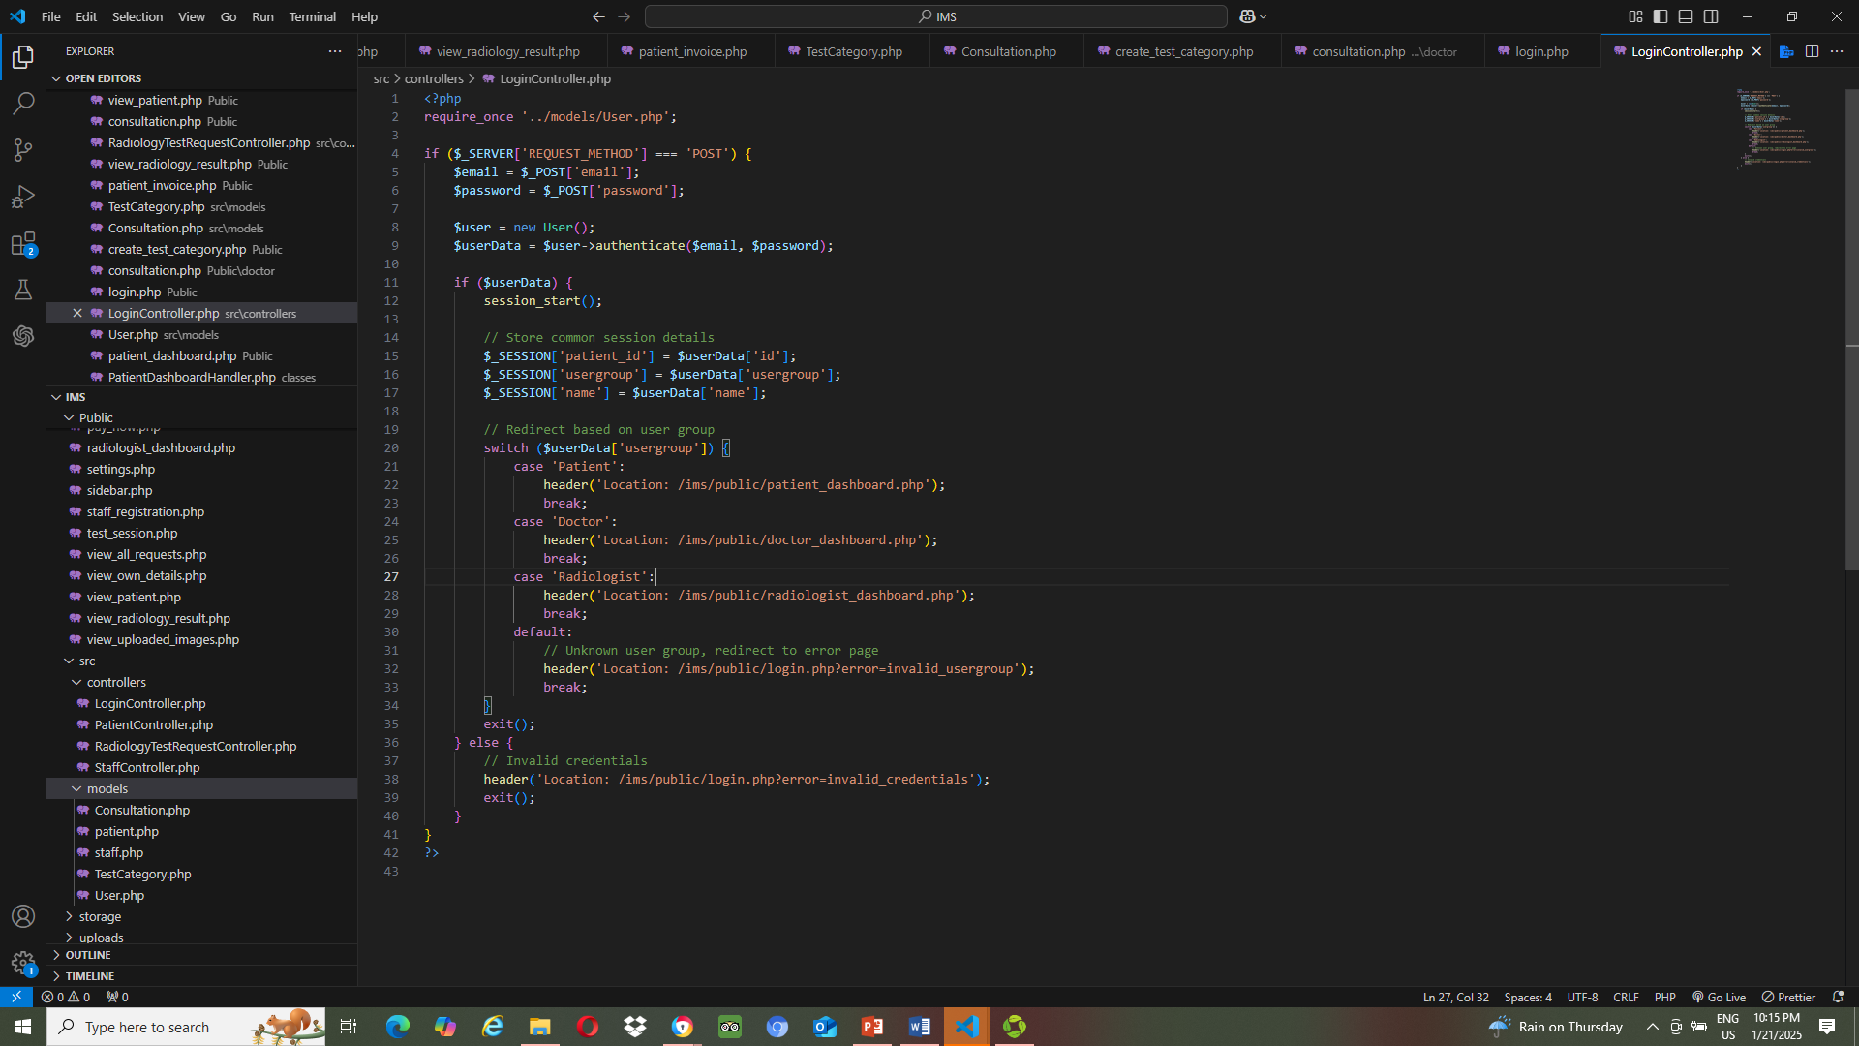
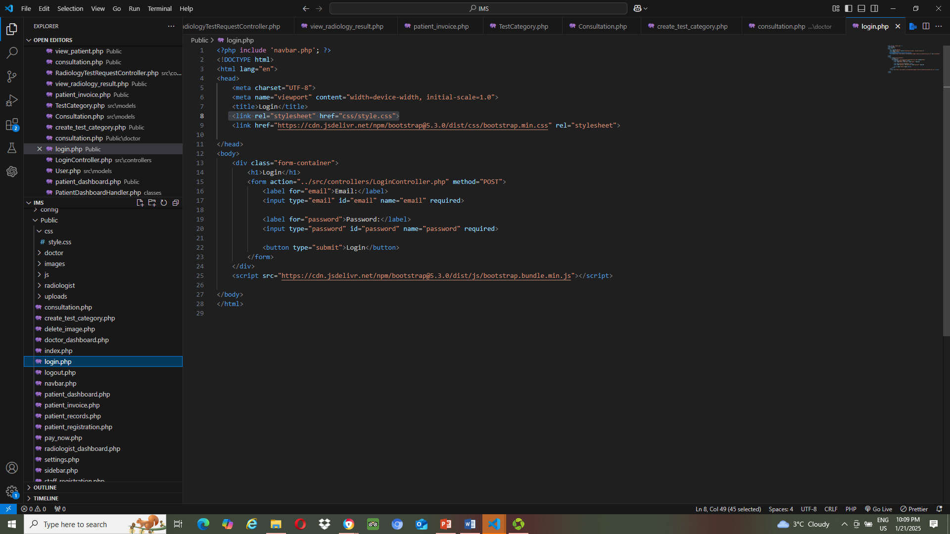
3. Snapshot of Code
Login.php
LoginContoller.php

Slide 12
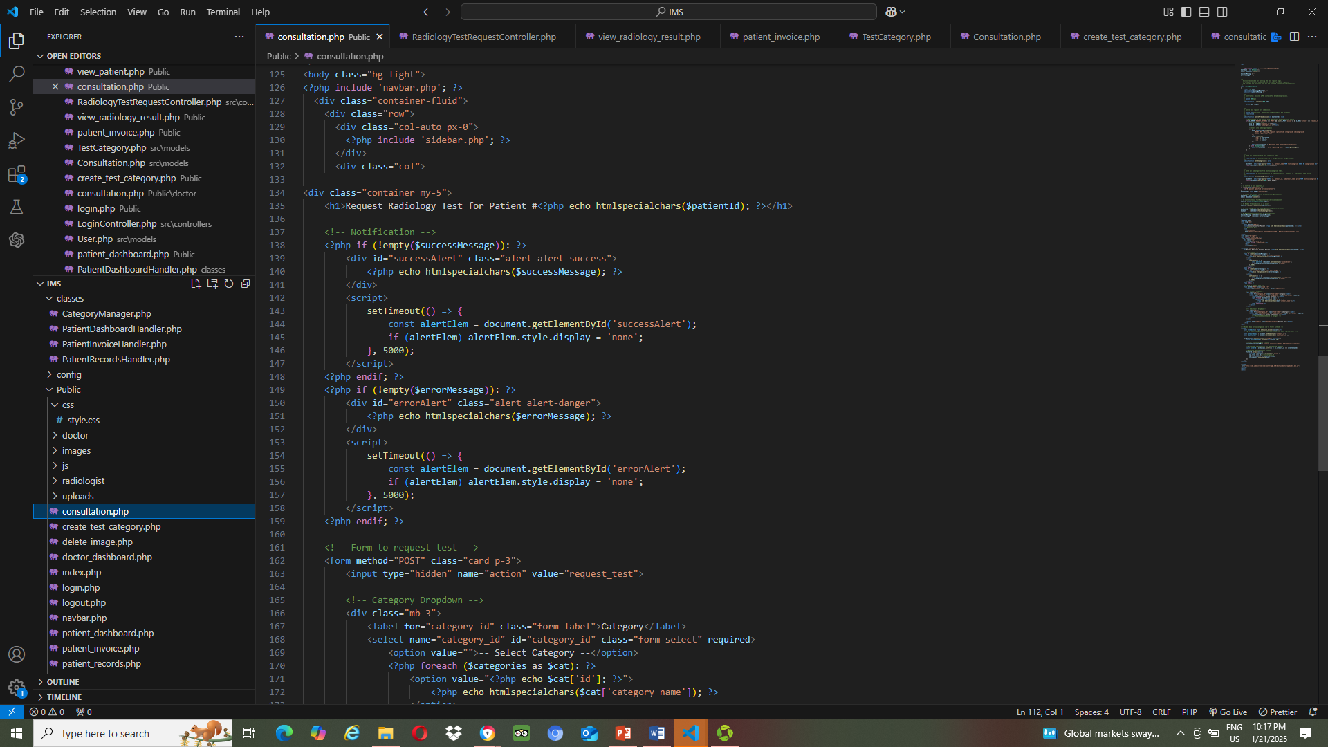
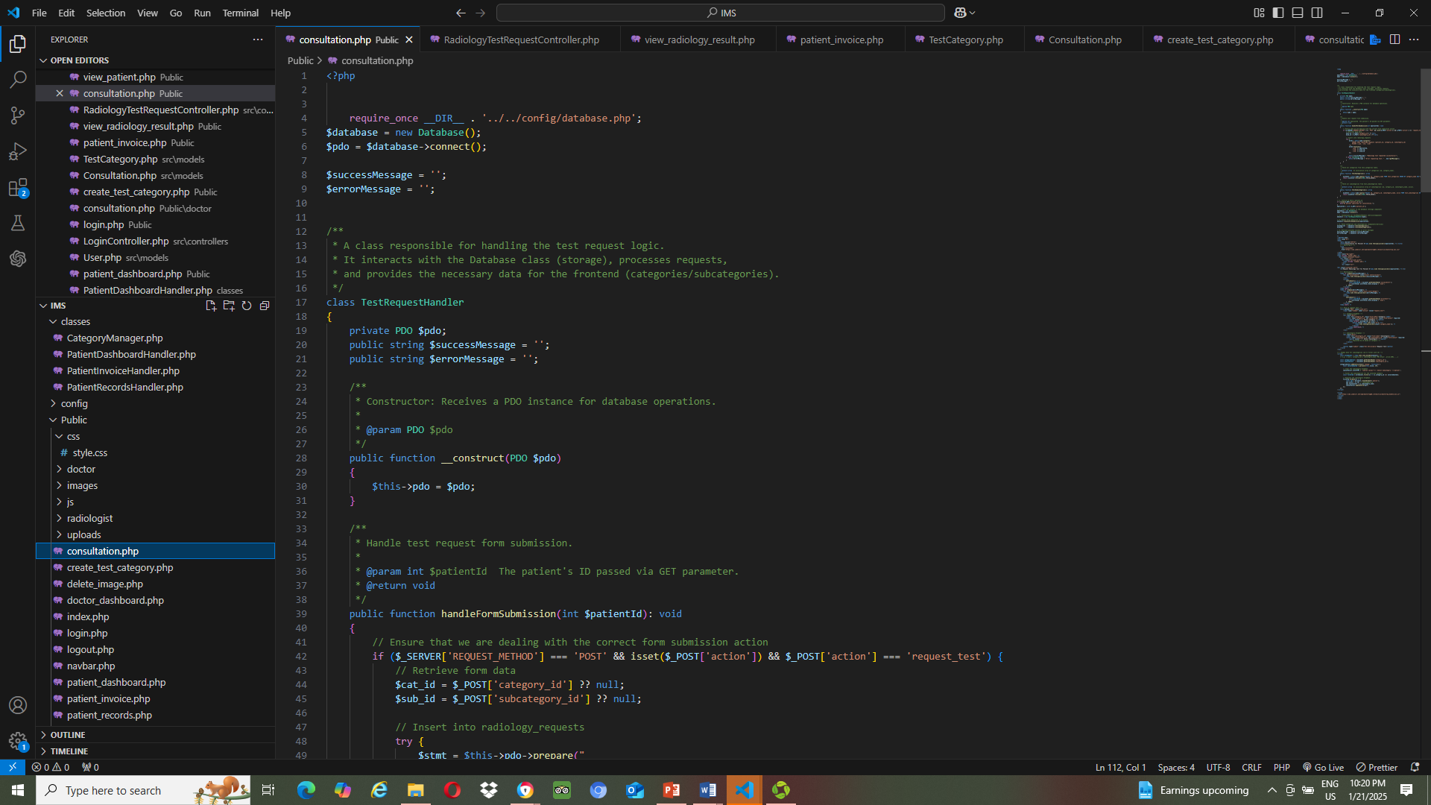
Snapshot of Code
Consultation.php
Consultation.php

Slide 13
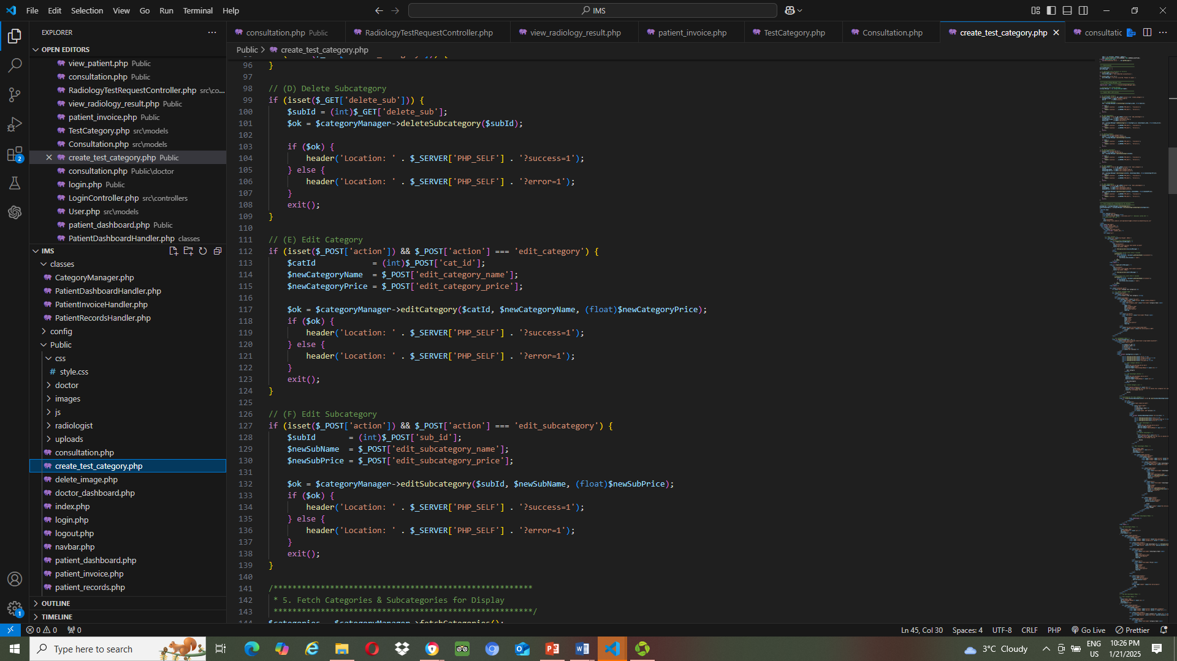
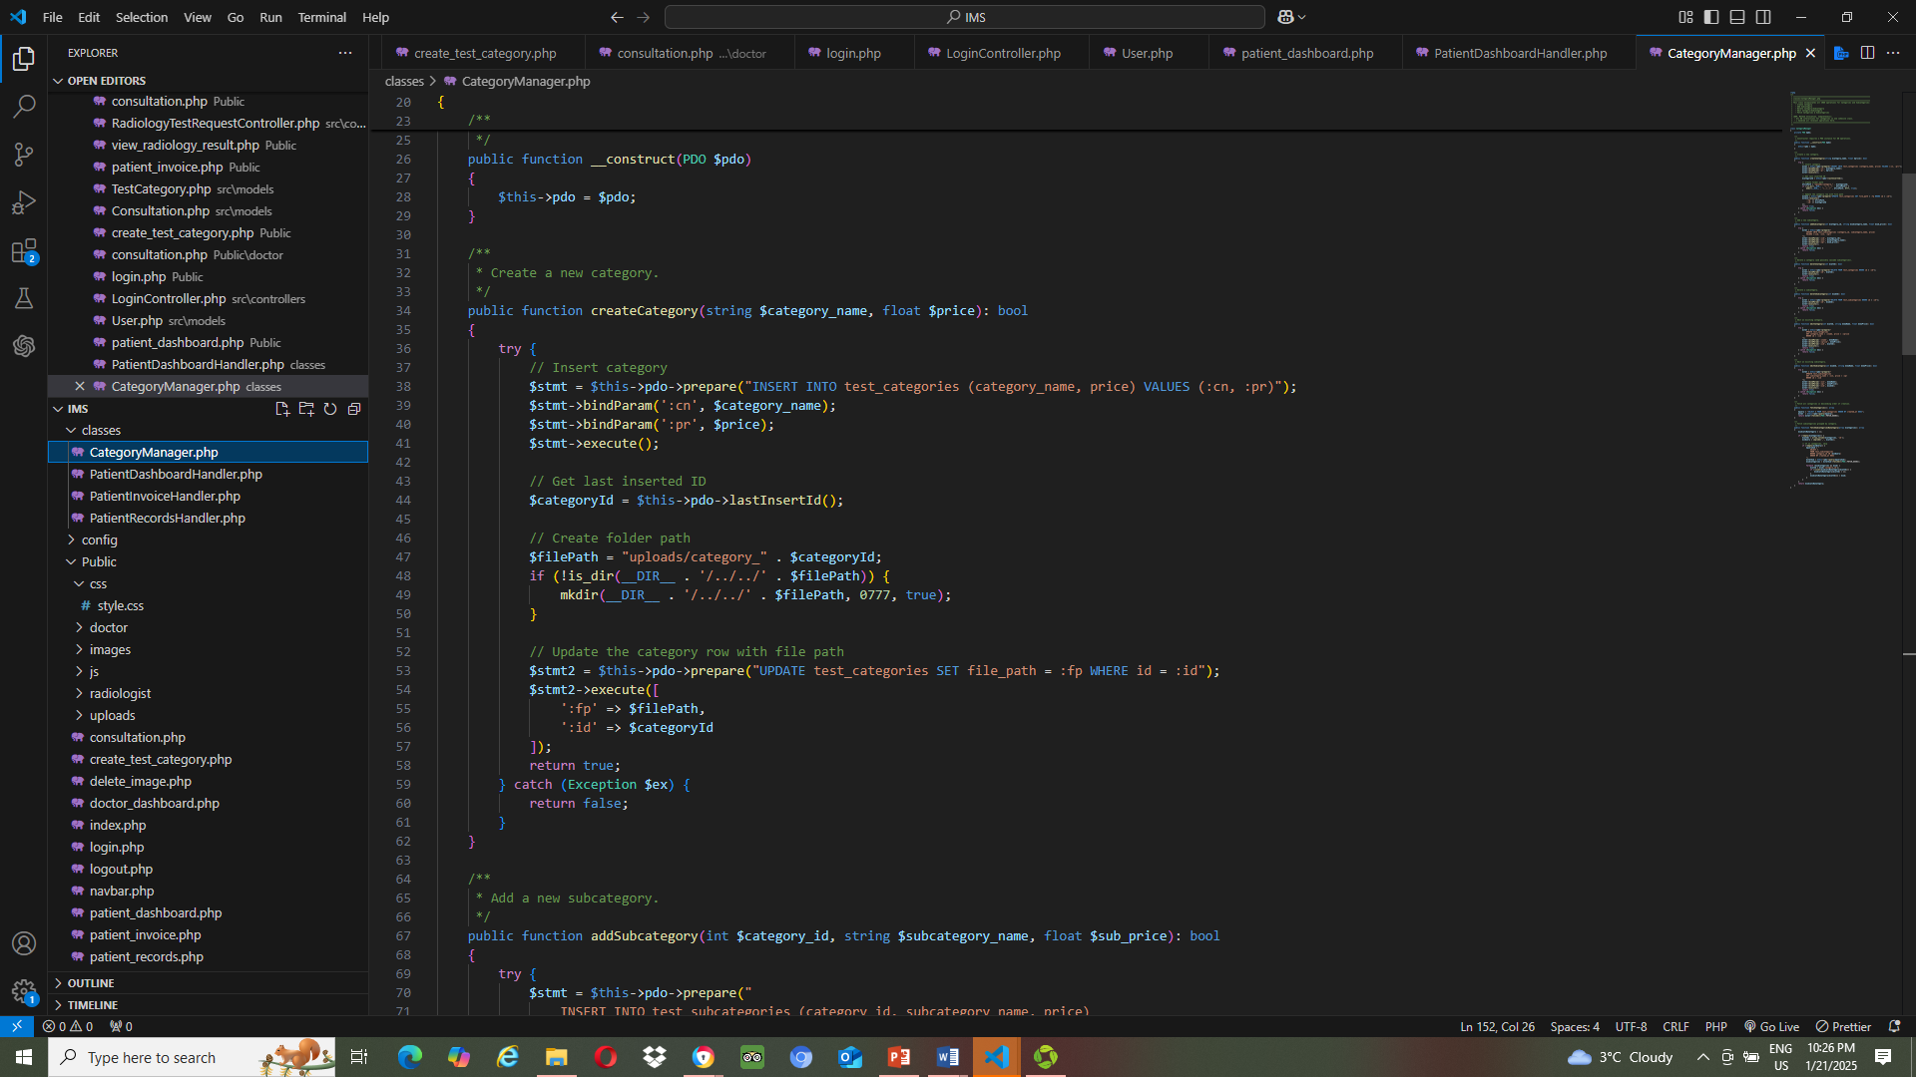
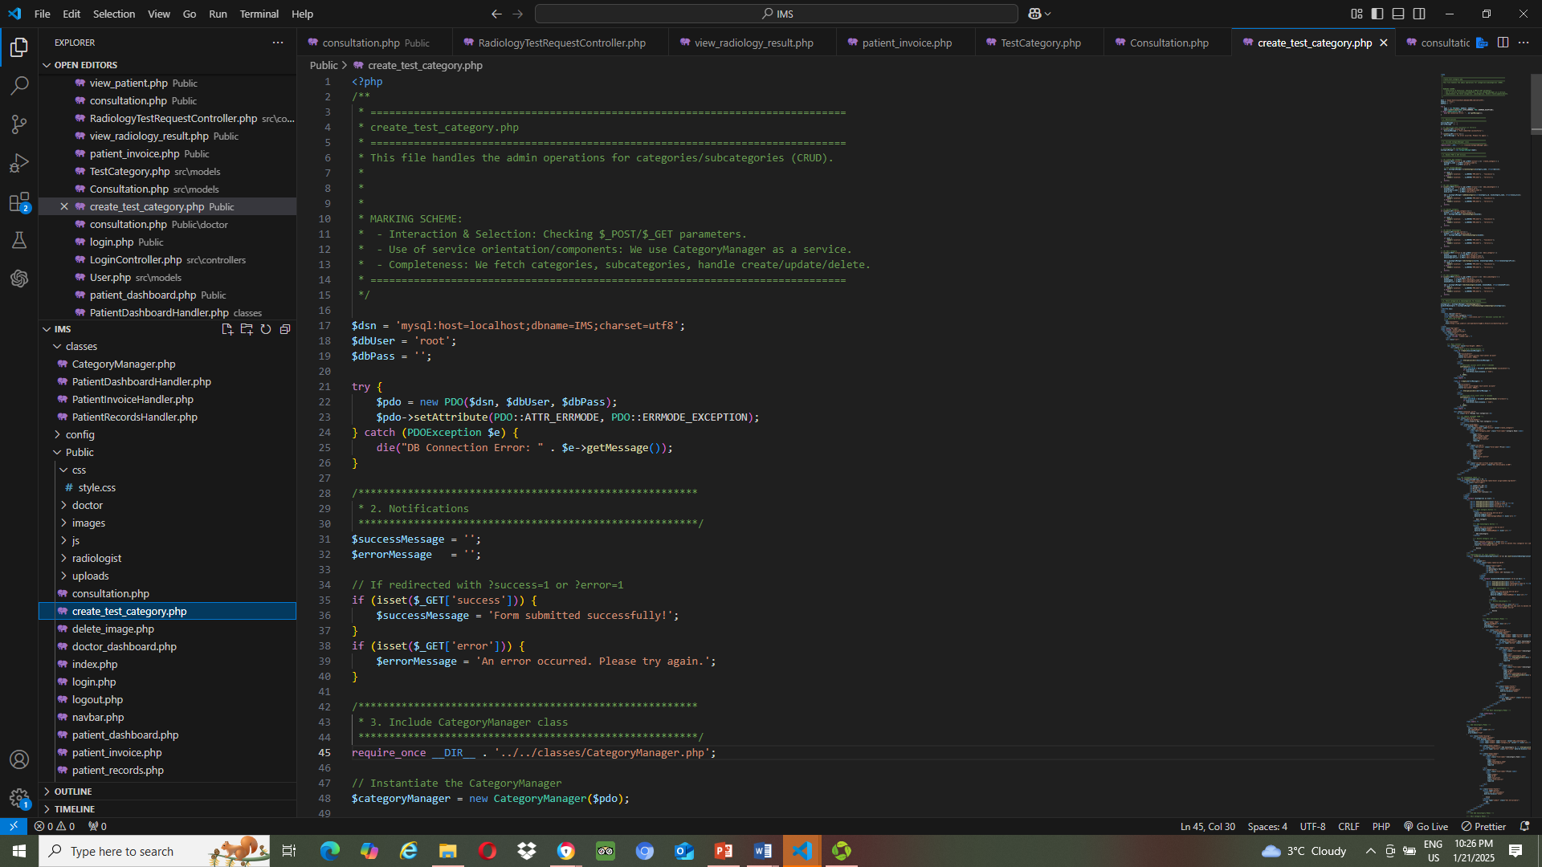
Create_test_category.php
Create_test_category.php
categoryManager.php

Slide 14
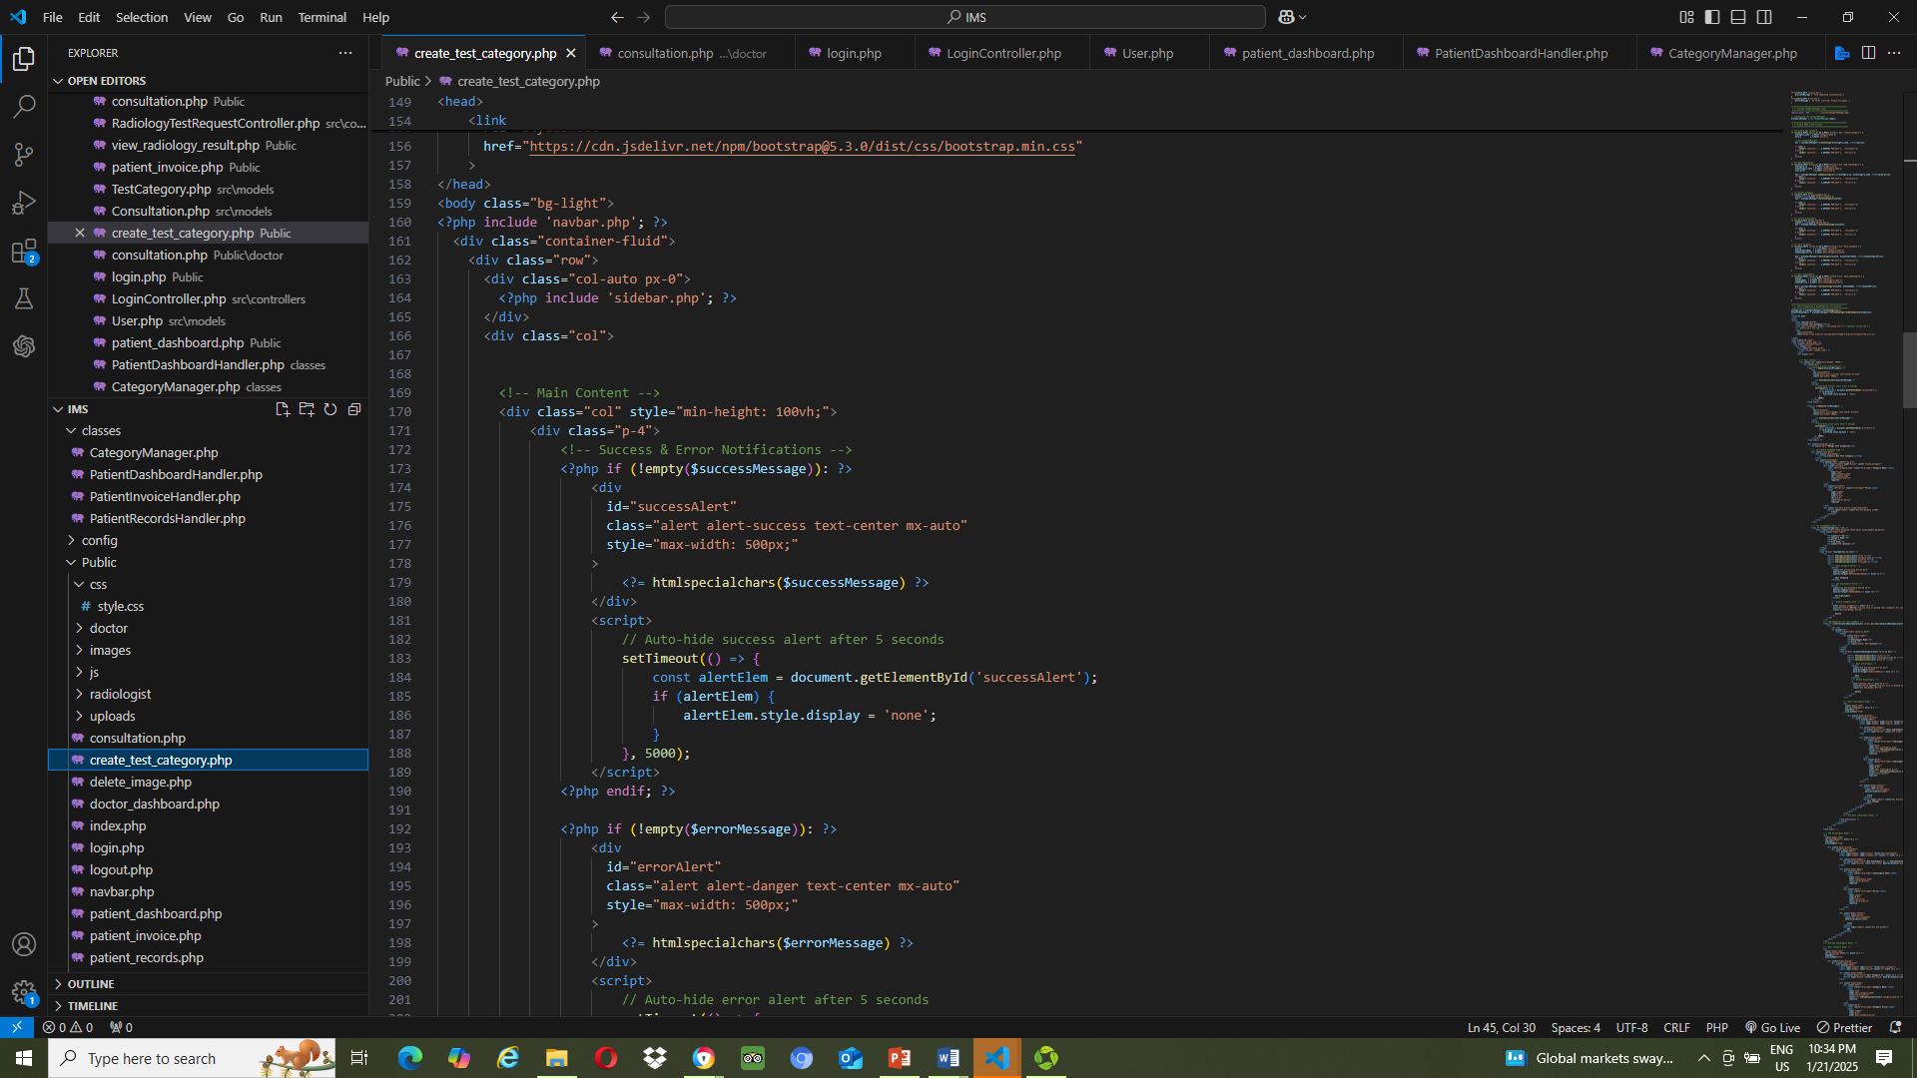
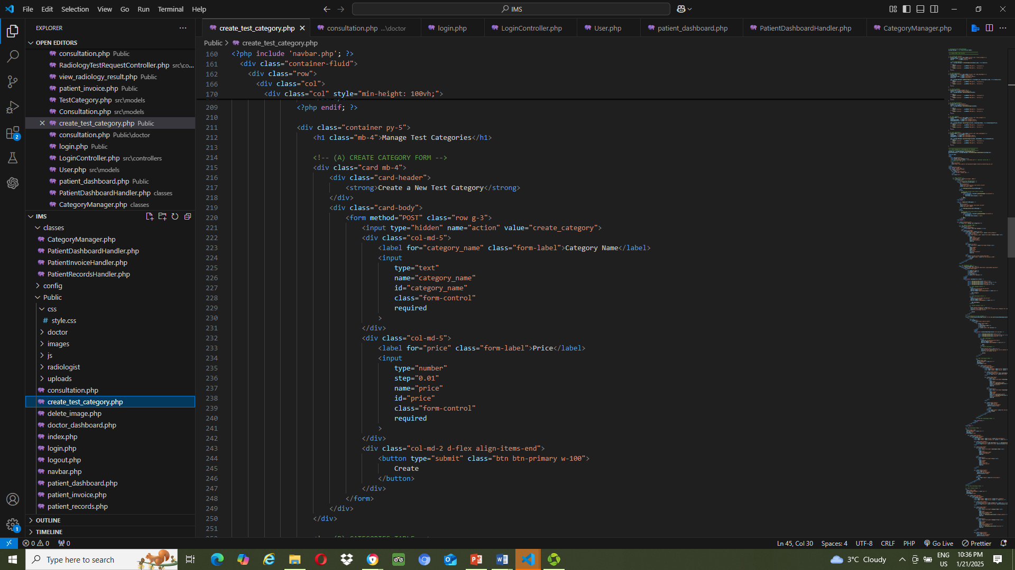
Create_test_category.php (view)

Slide 15

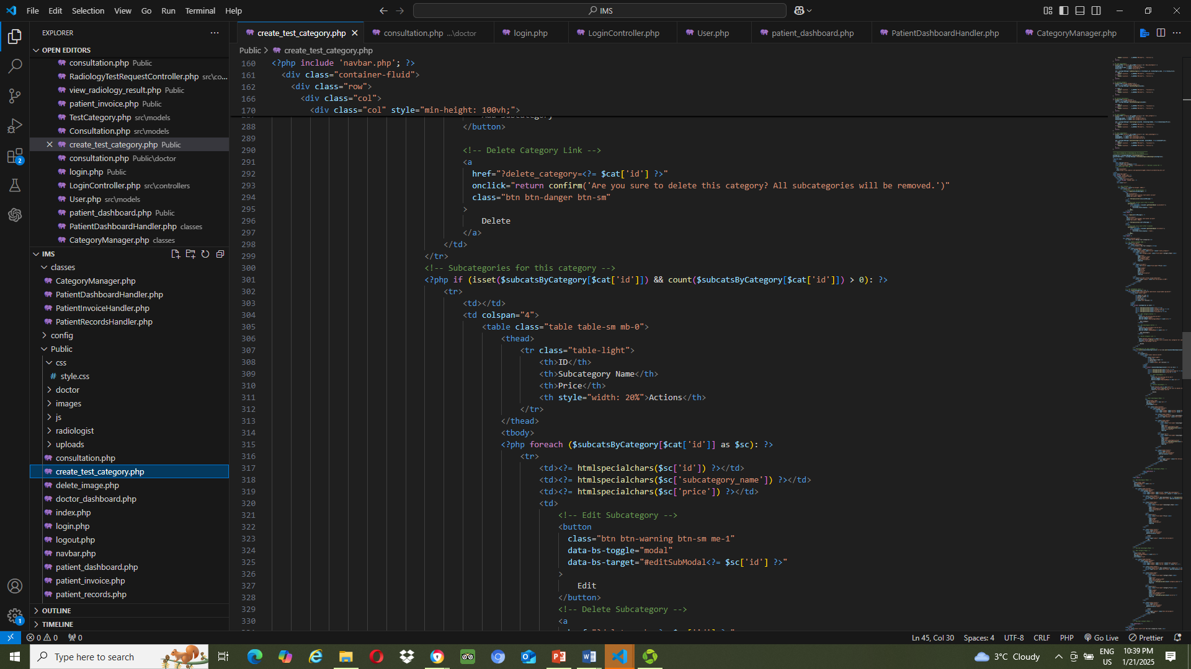
Create_test_category.php (view)

Slide 16
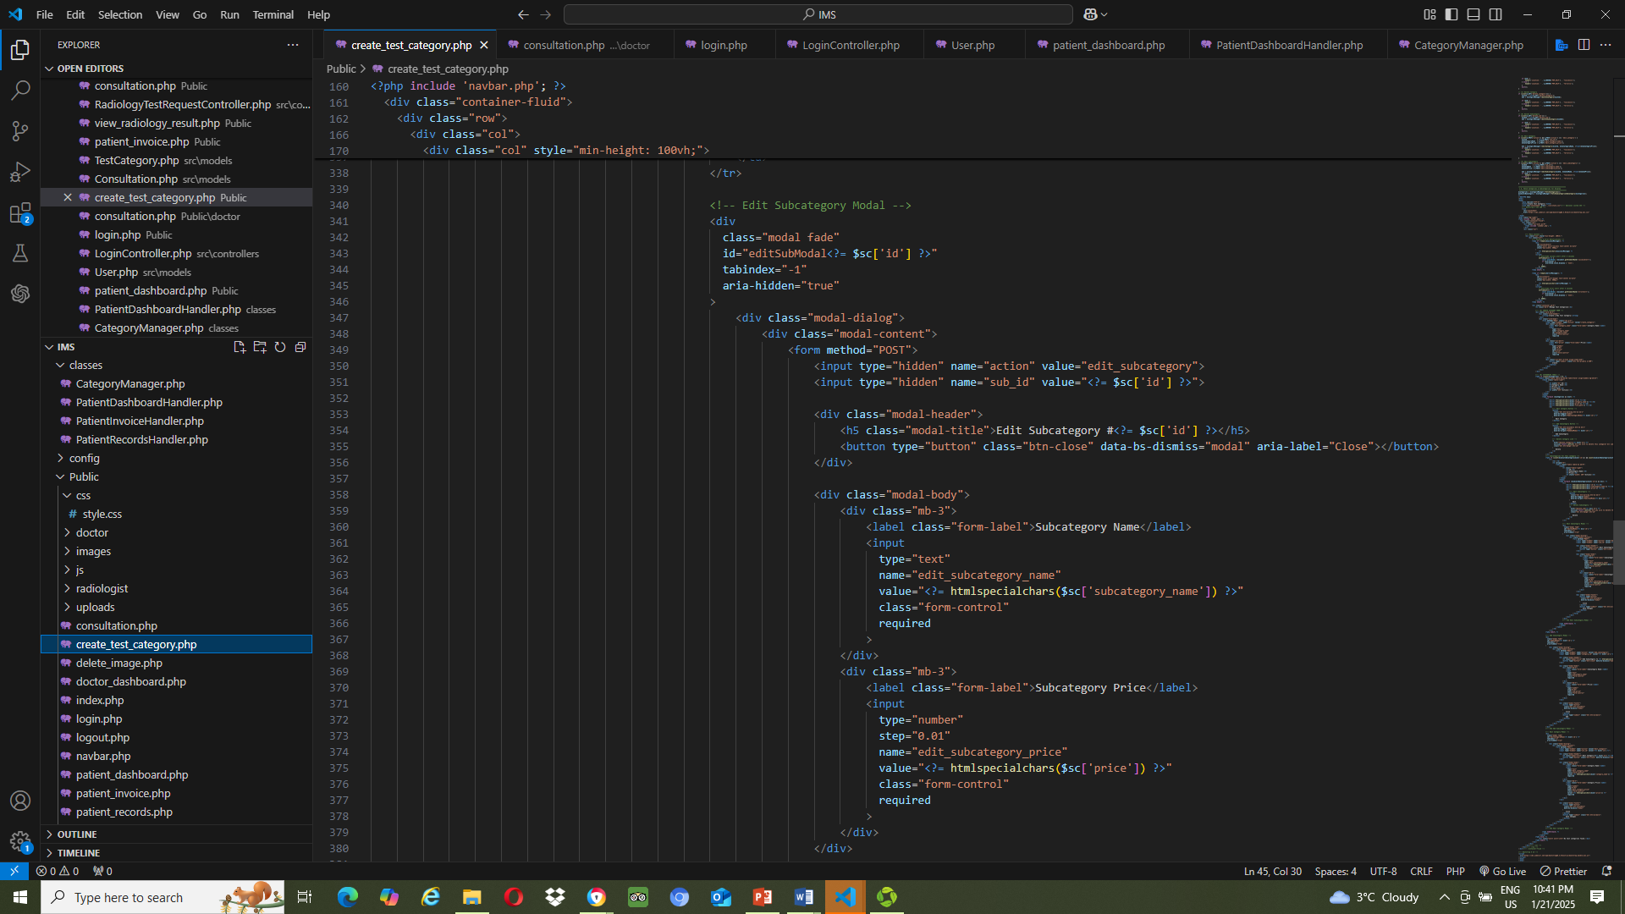
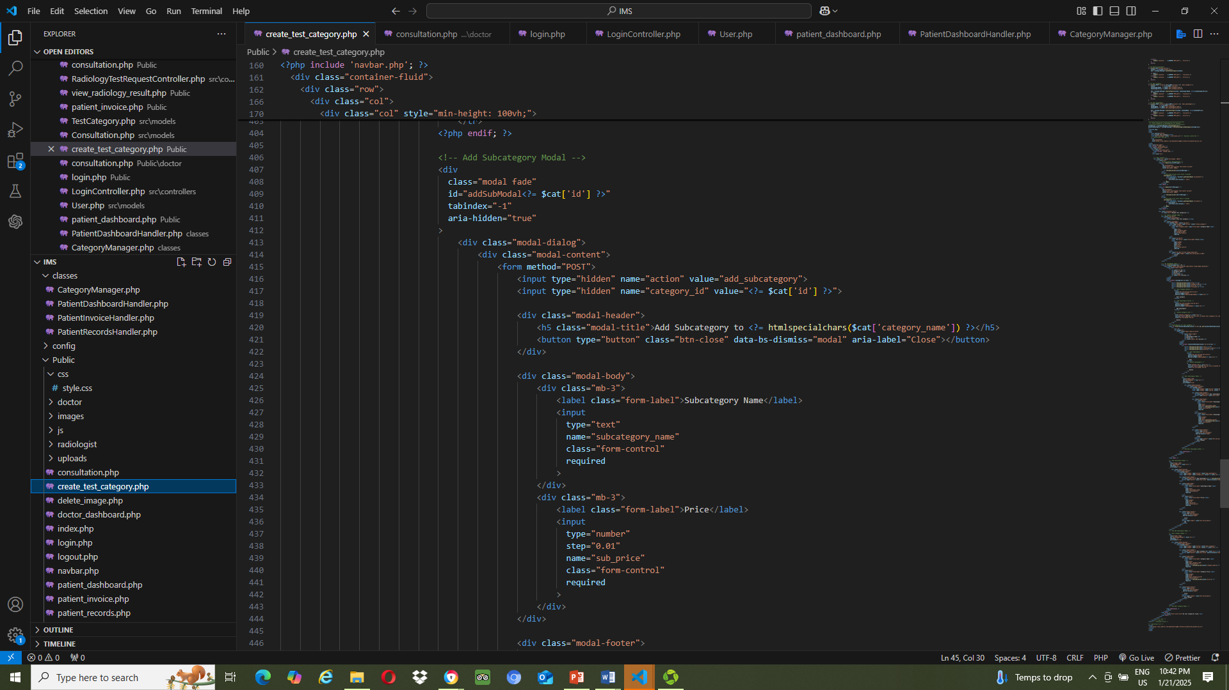
Create_test_category.php (view)

Slide 17
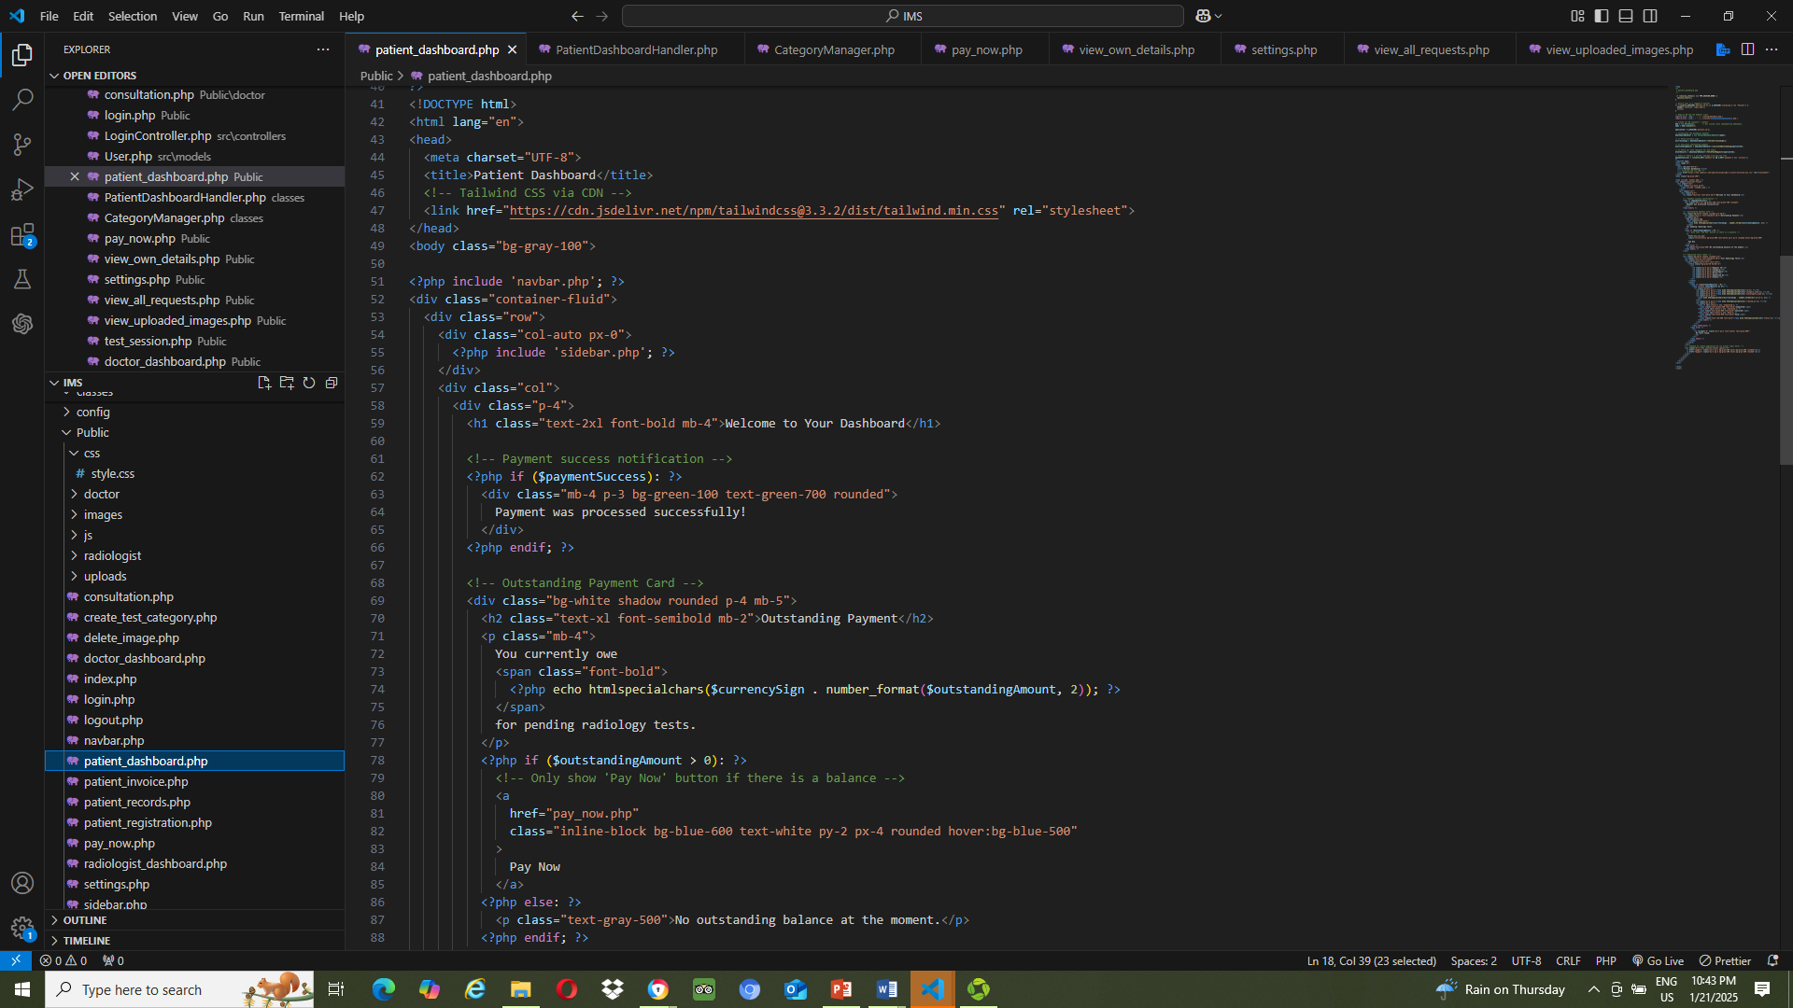
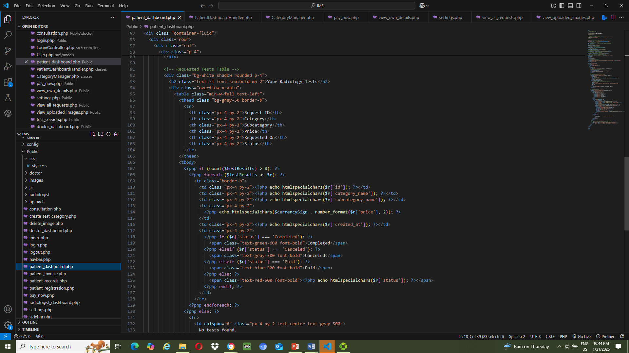
Patient_dashboard.php (view)

Slide 18
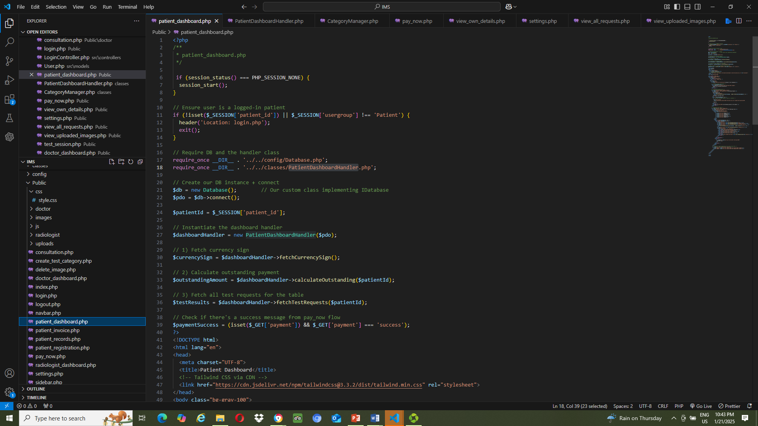
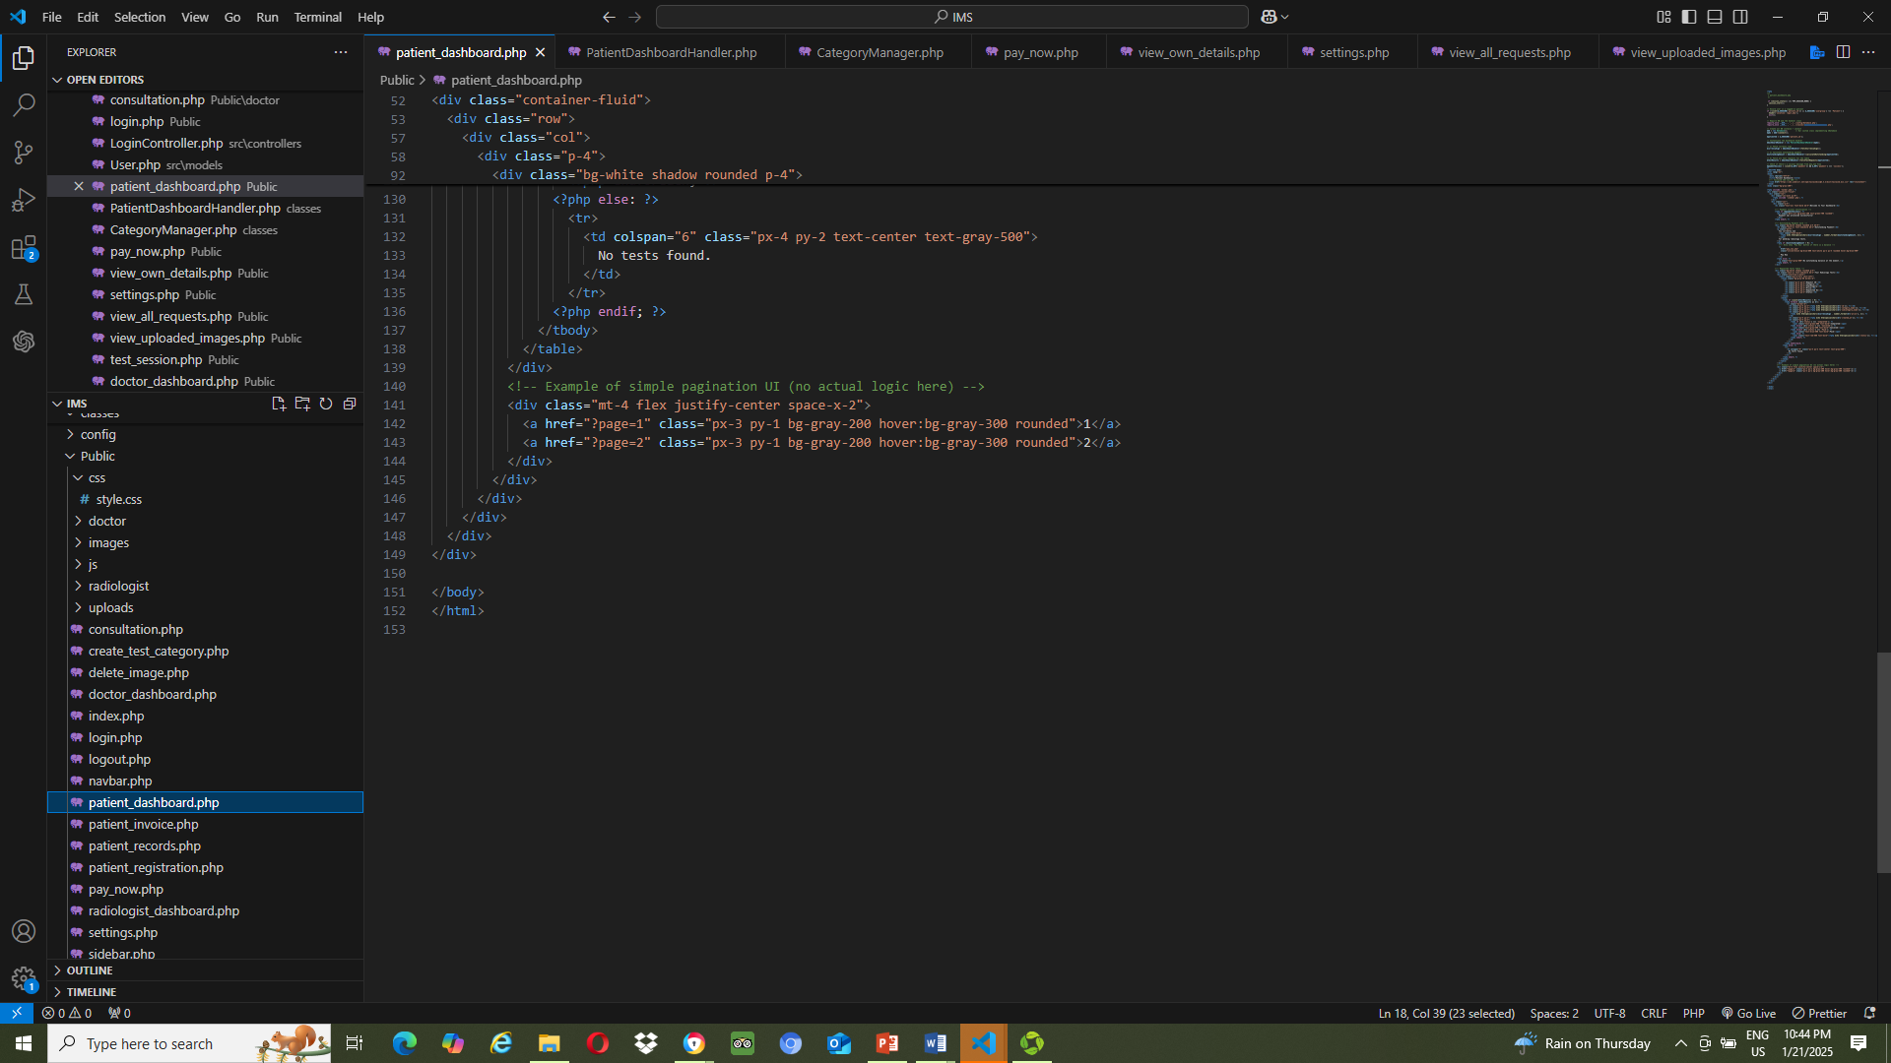
Patient_dashboard.php
Patient_dashboard.php (view)

Slide 19
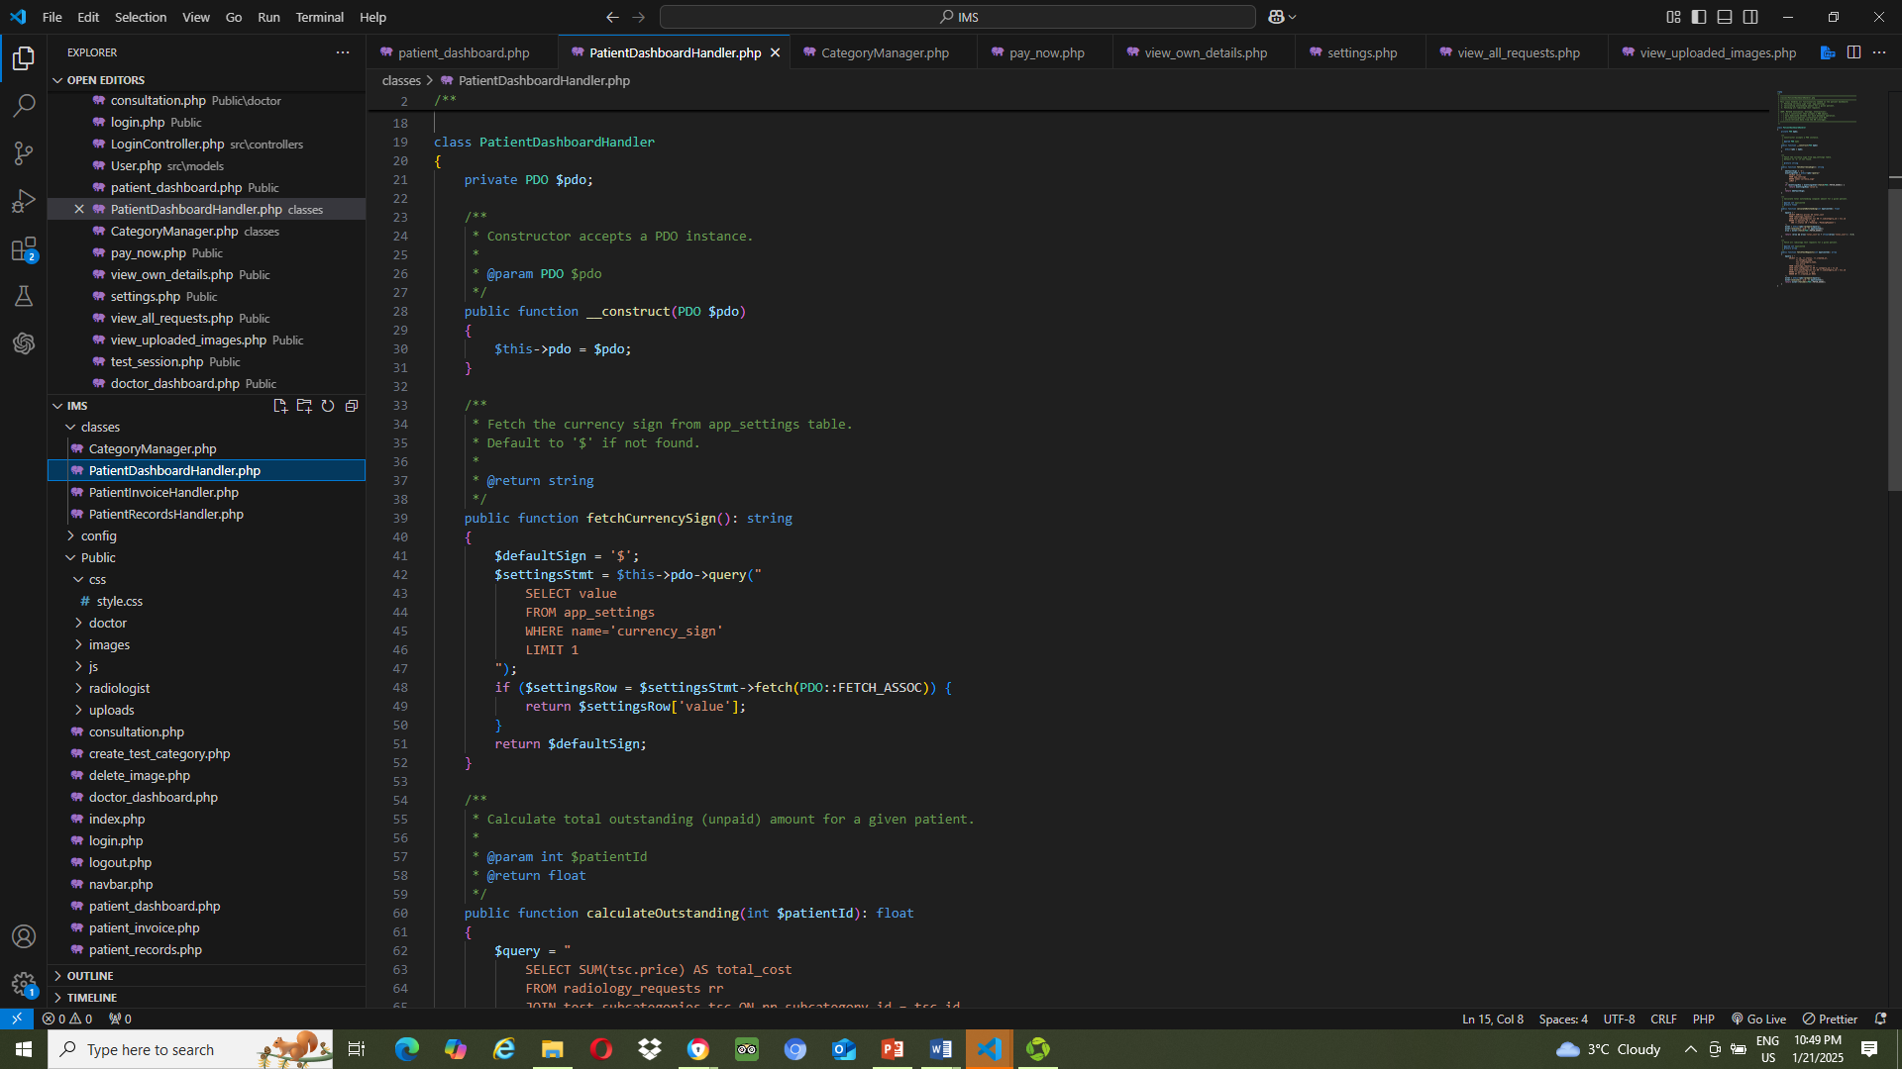
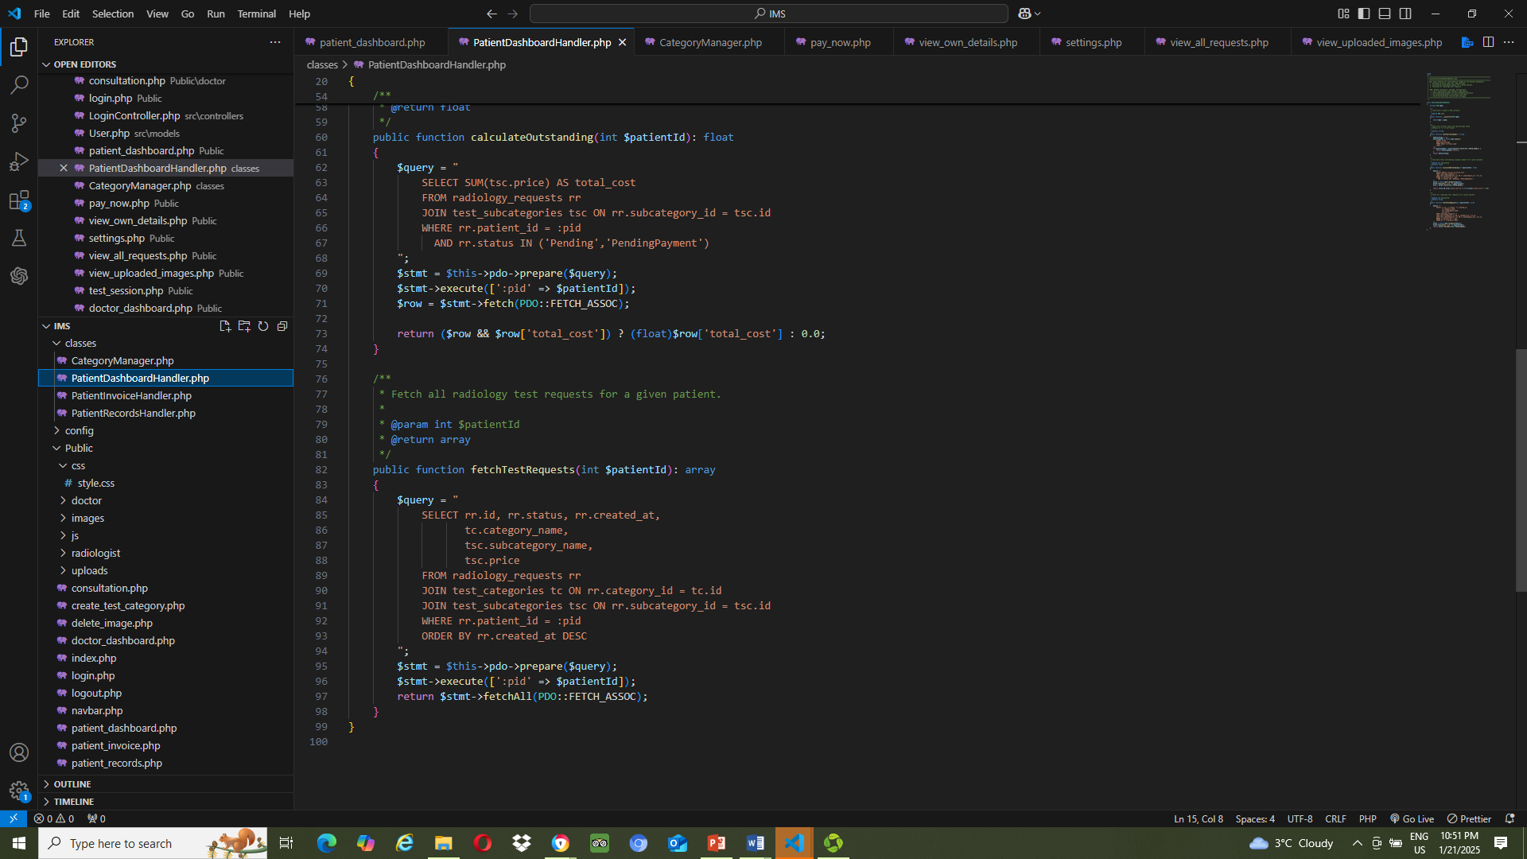
PatientDashboardHandler.php

Slide 20
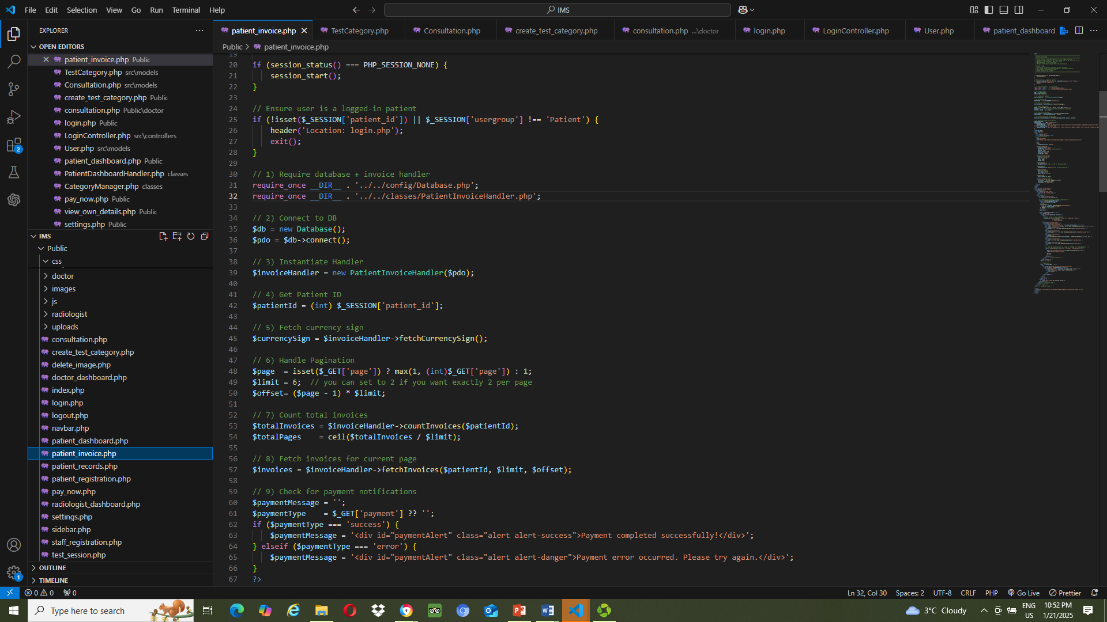
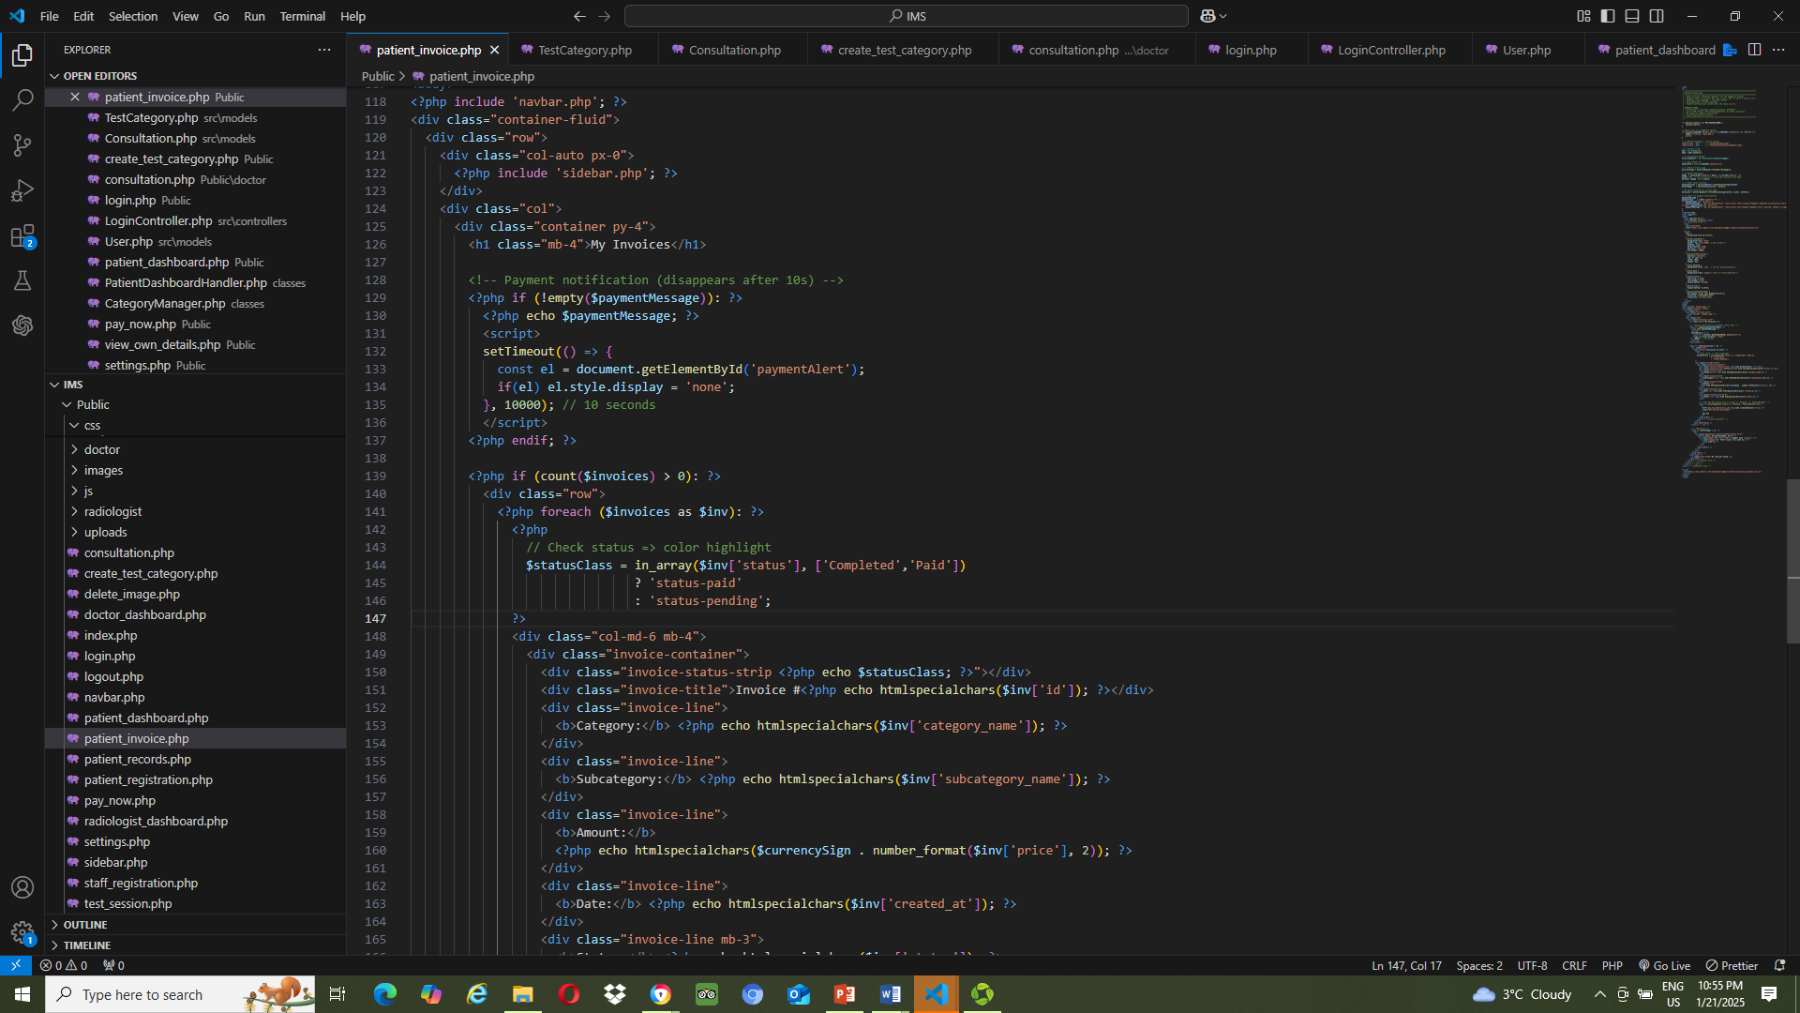
Patient_invoice.php (view)
Patient_invoice.php

Slide 21
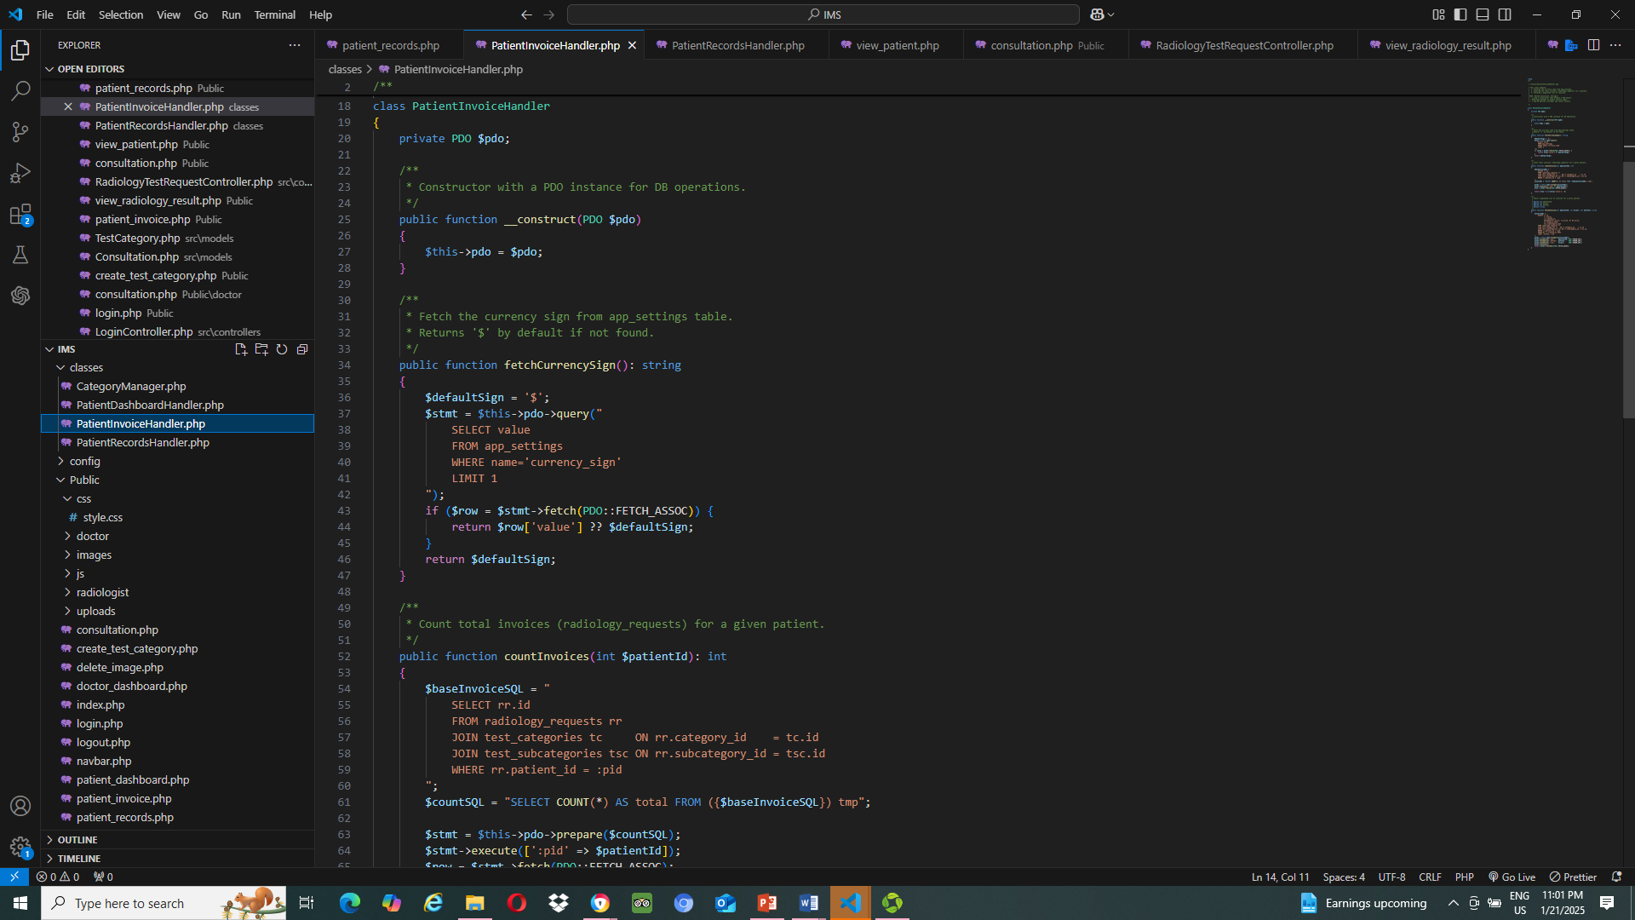
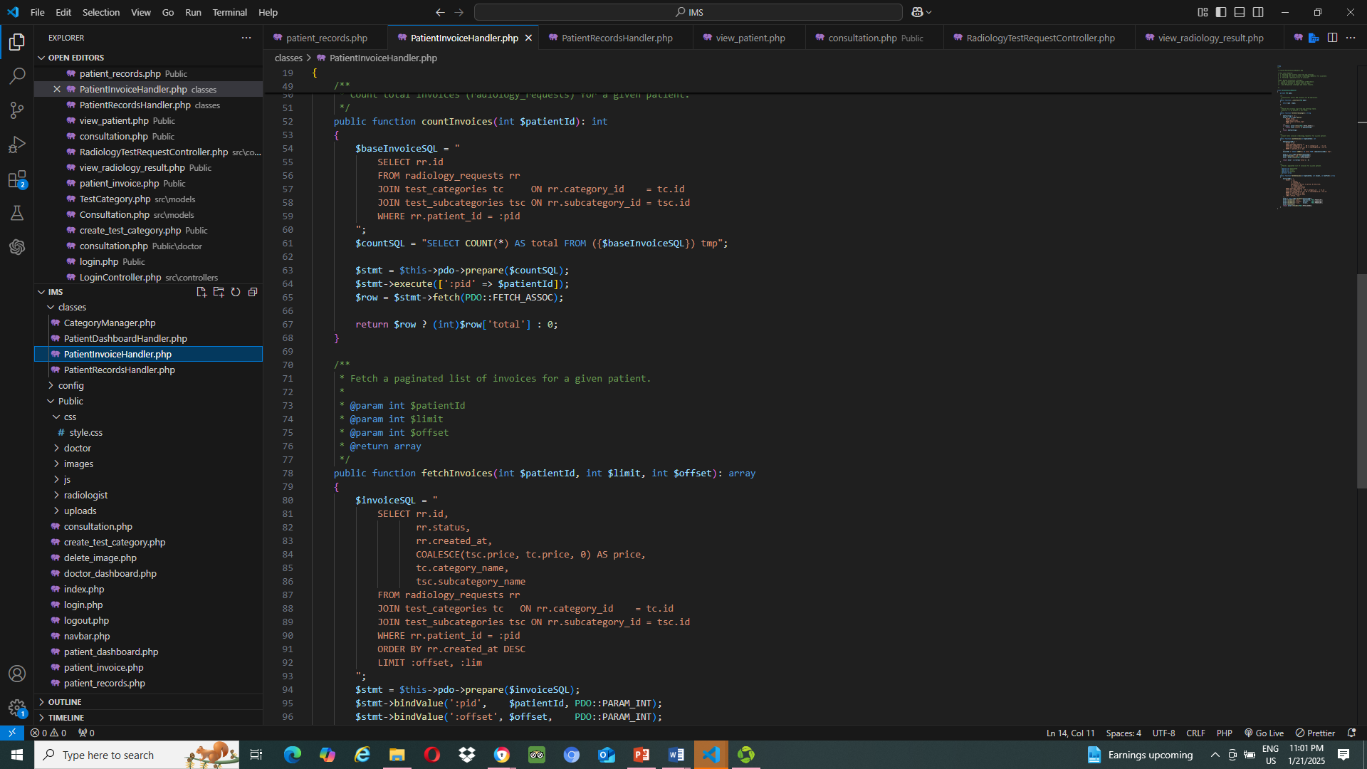
PatientInvoiceHandler.php

Slide 22
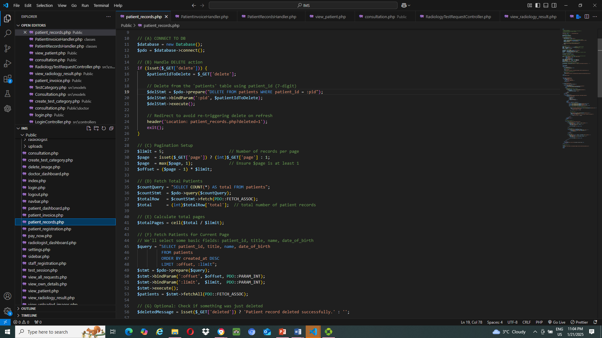
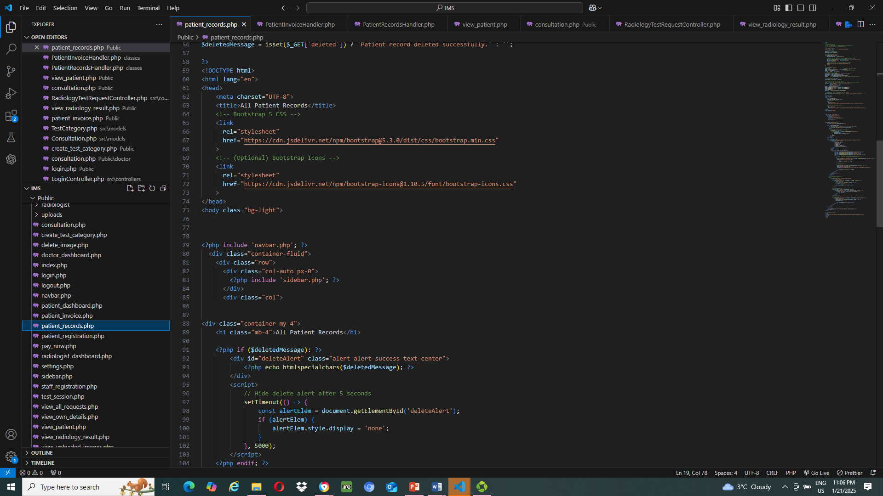
Patient_record.php
Patient_record.php (view)

Slide 23
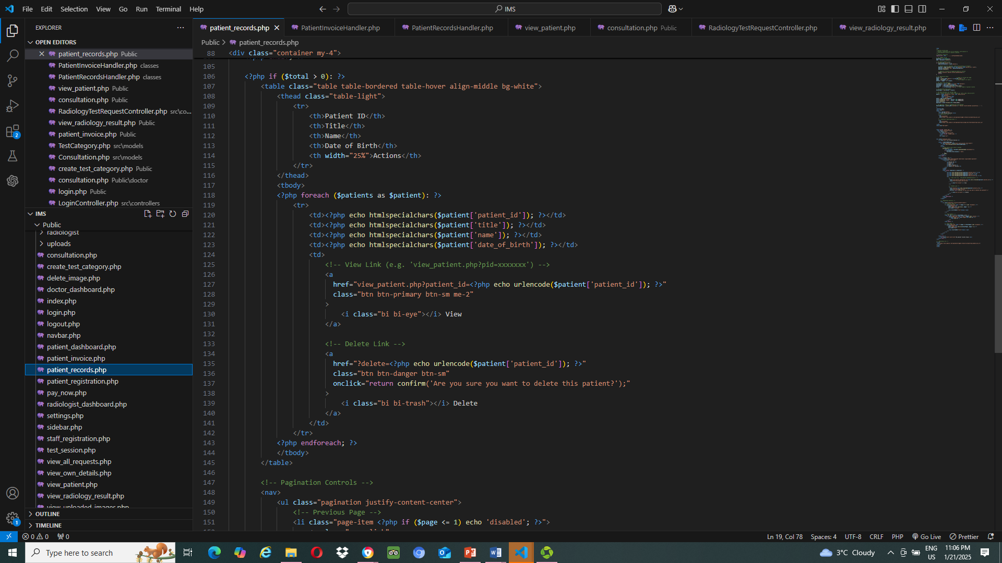
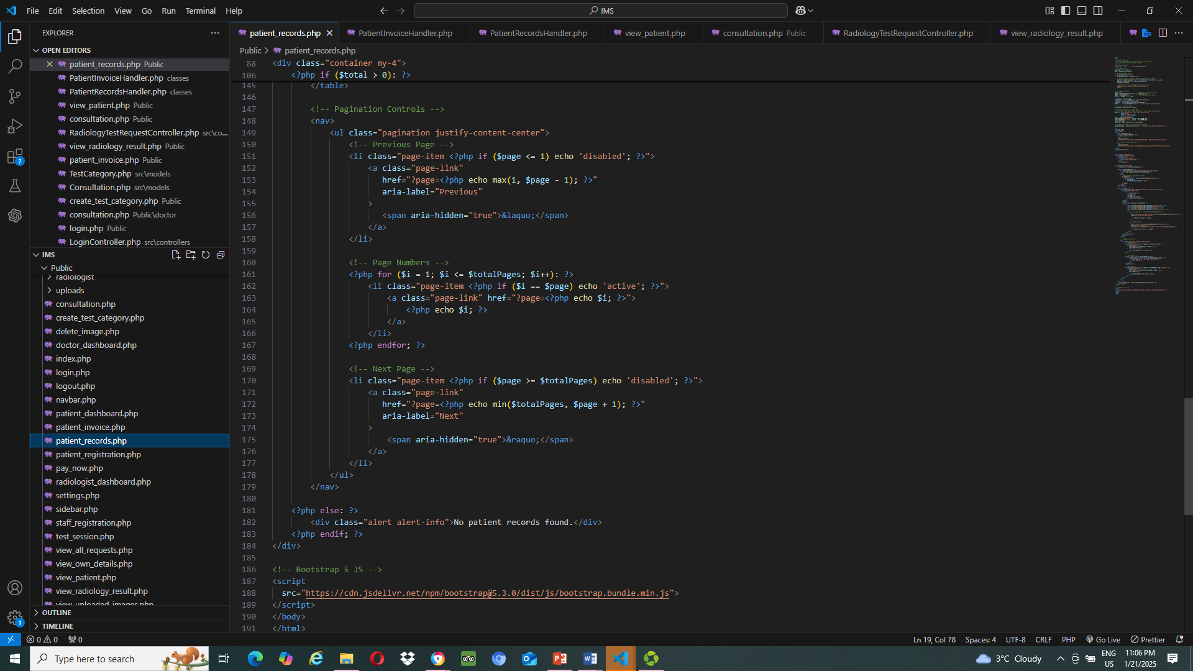
Patient_record.php (view)

Slide 24
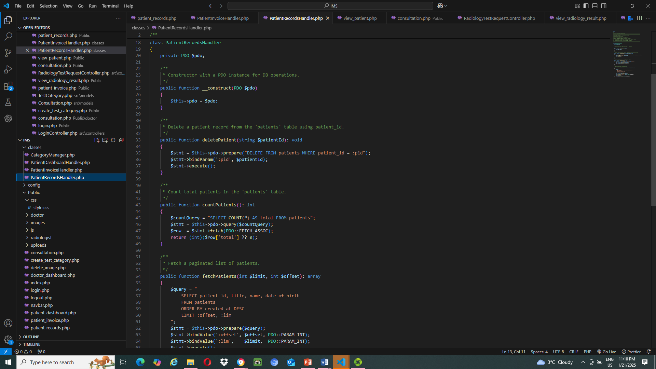
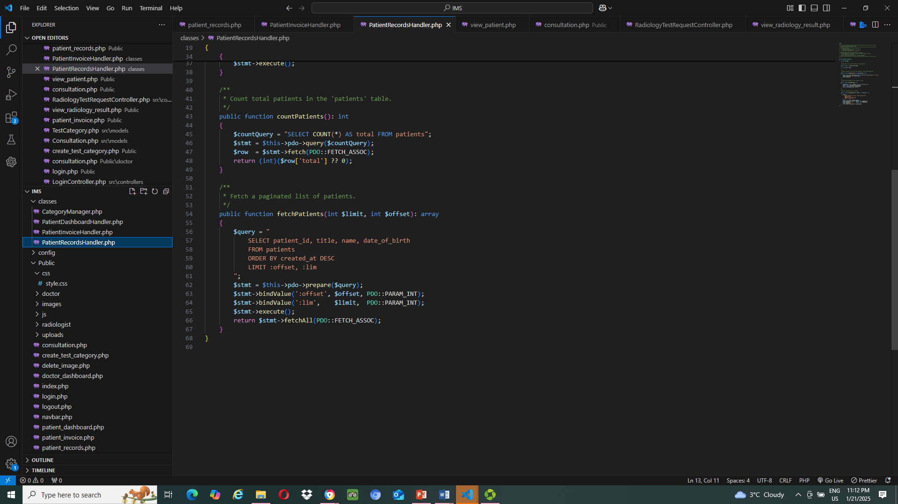
PatientRecordHandler.php (view)

Slide 25
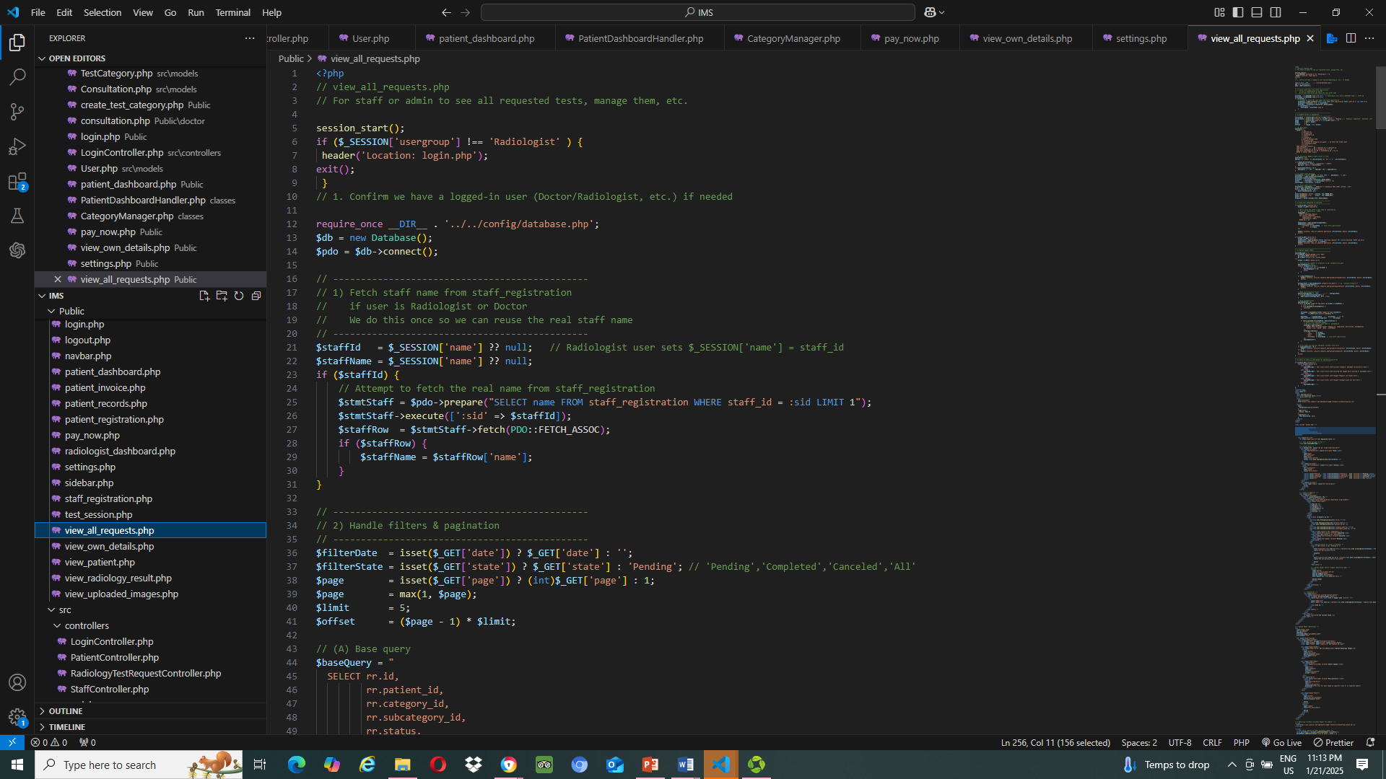
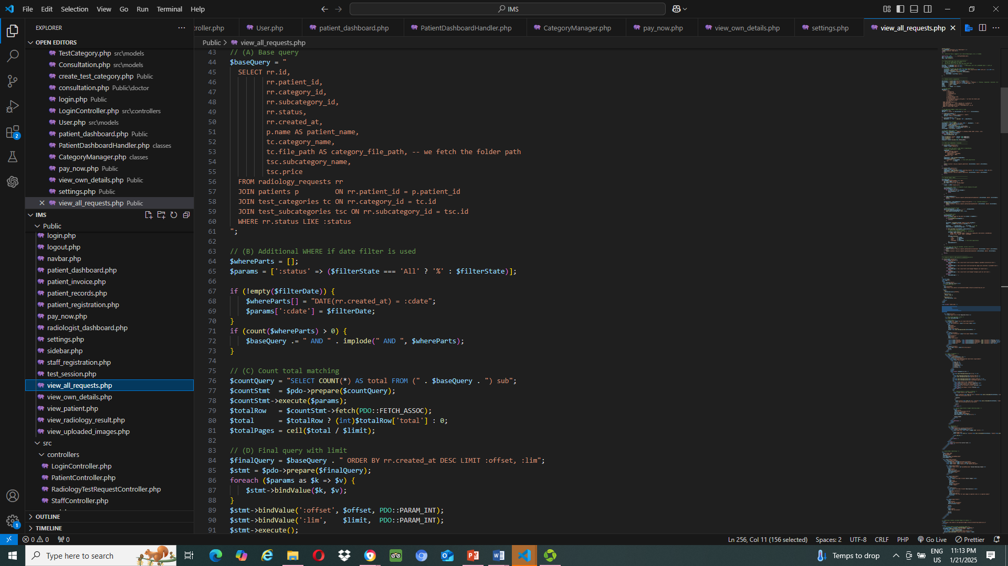
View_all_rerquests.php

Slide 26
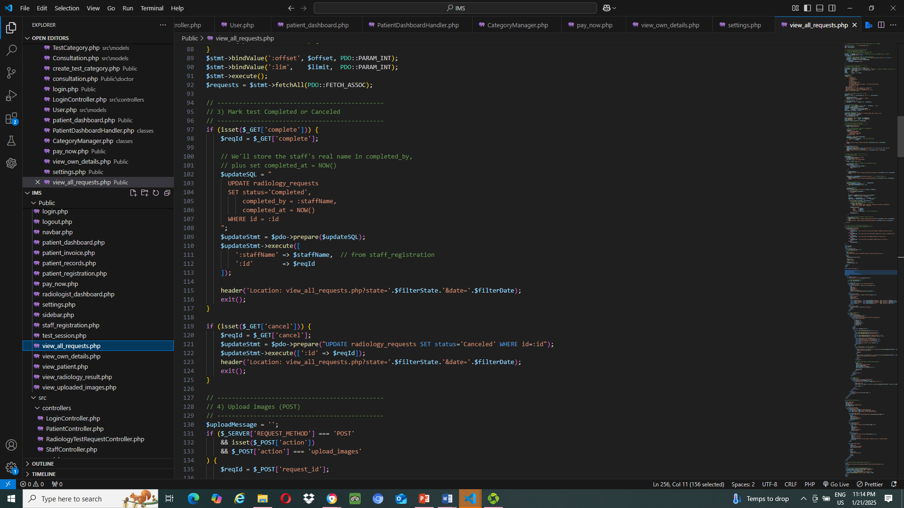
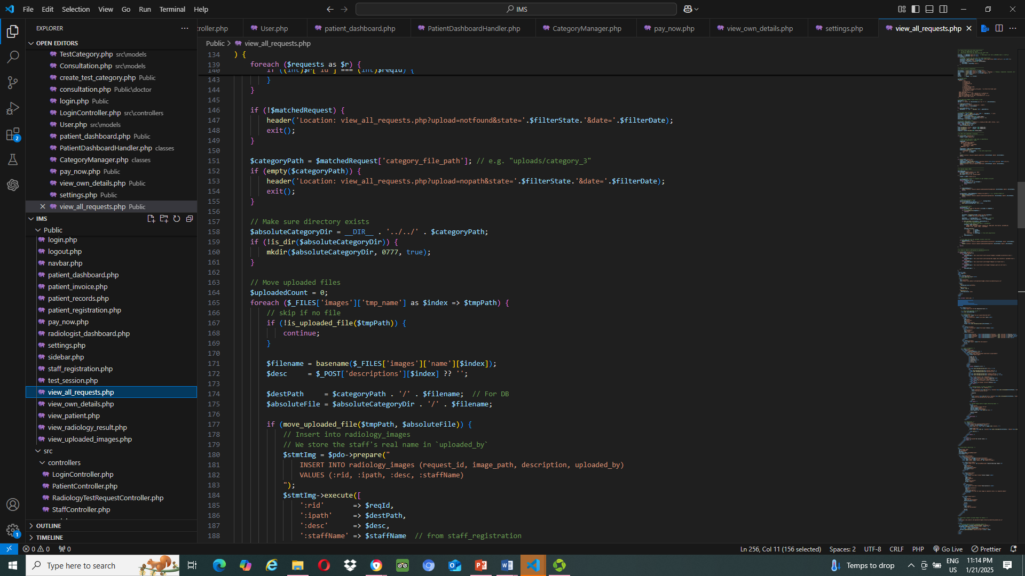
View_all_rerquests.php

Slide 27
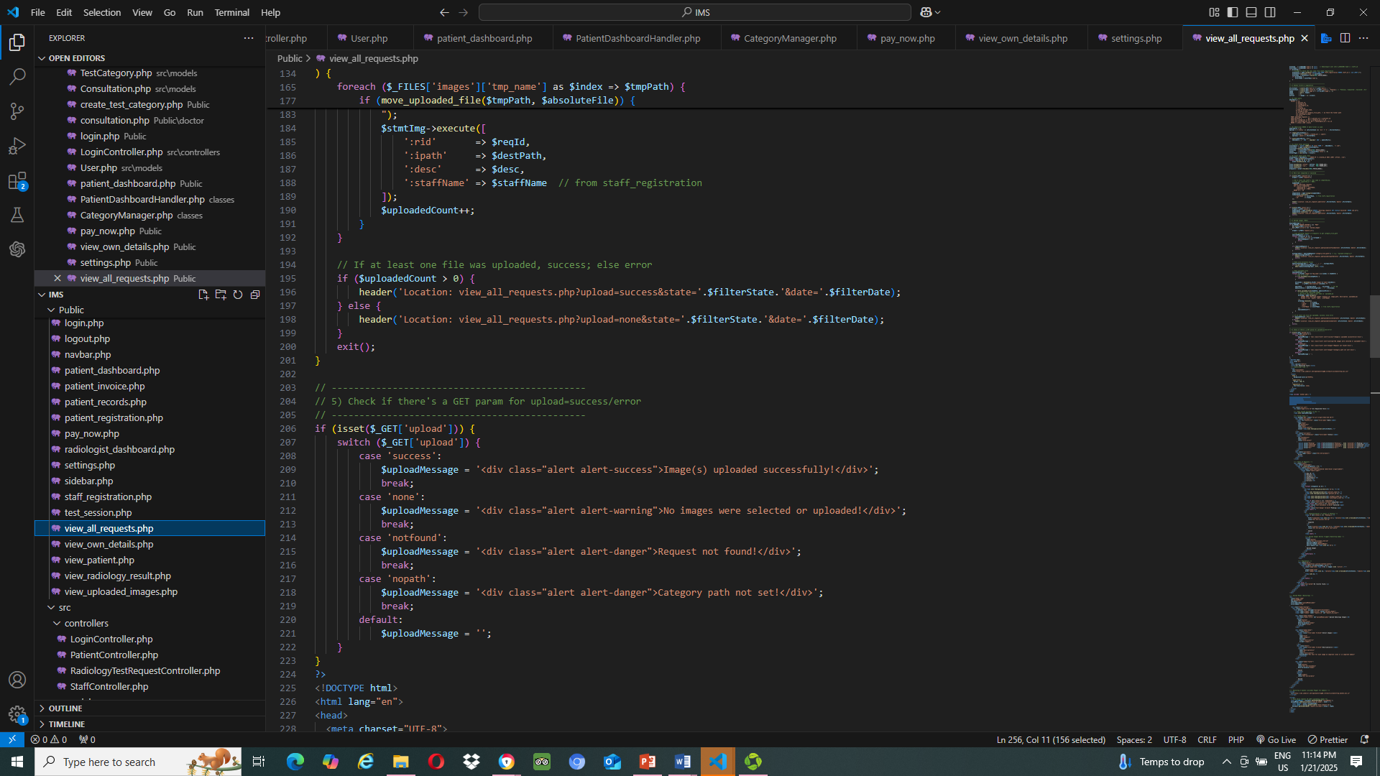
View_all_rerquests.php

Slide 28
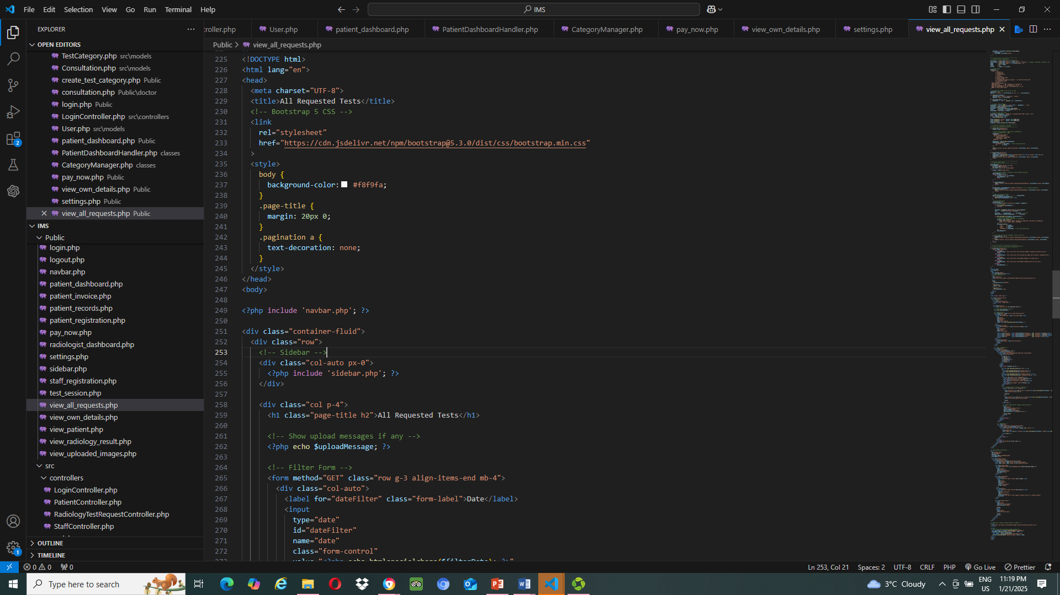
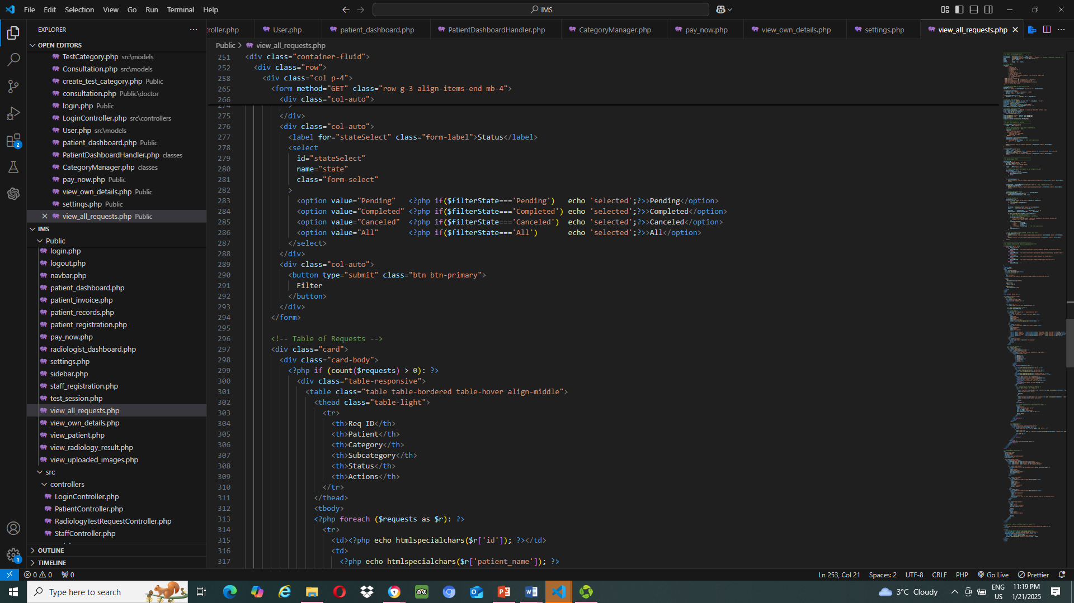
View_all_rerquests.php (view)

Slide 29
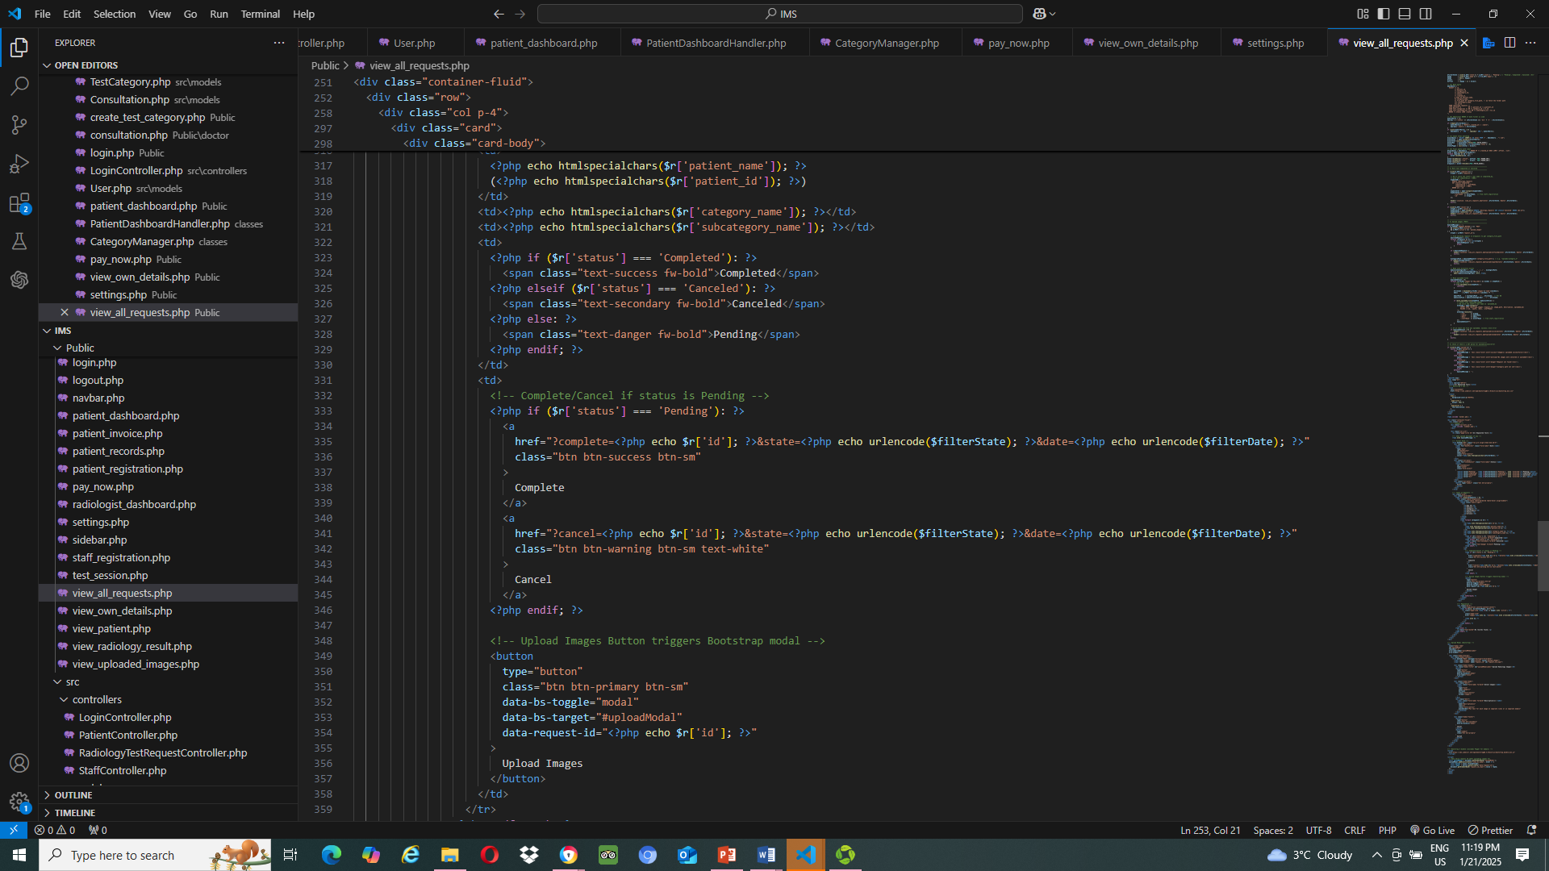
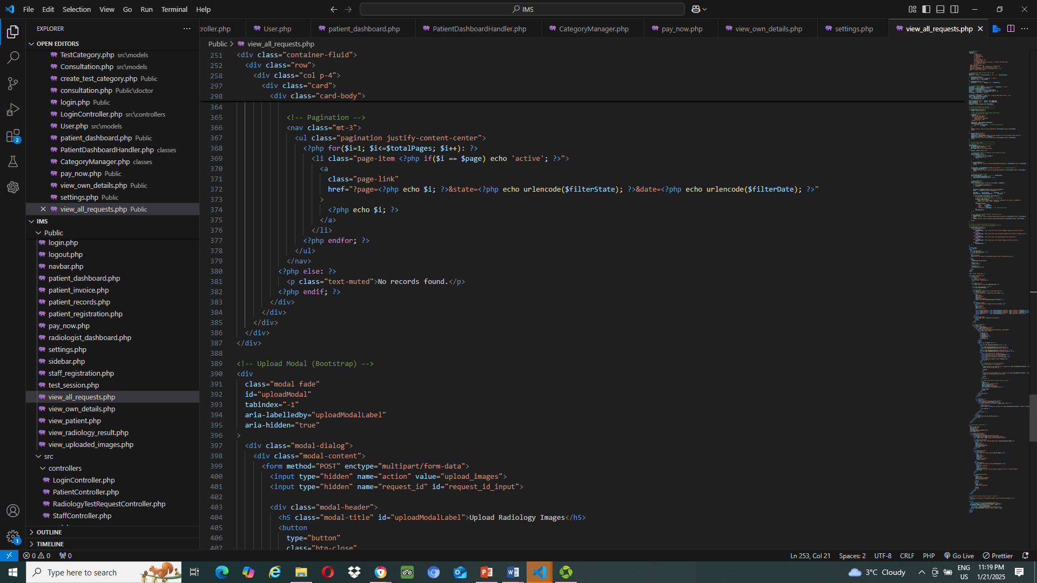
View_all_rerquests.php (view)

Slide 30
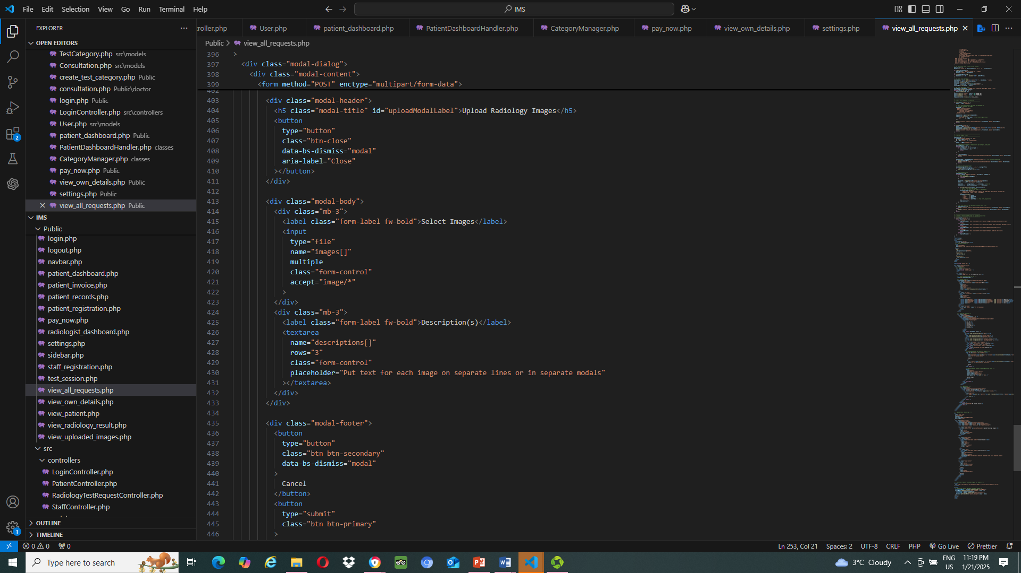
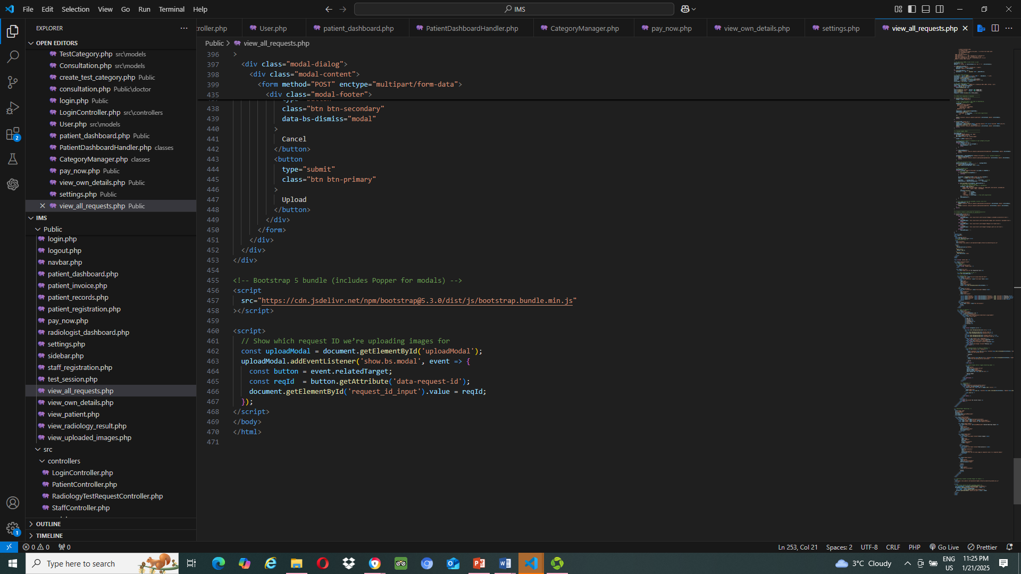
View_all_requests.php (view)

Slide 31
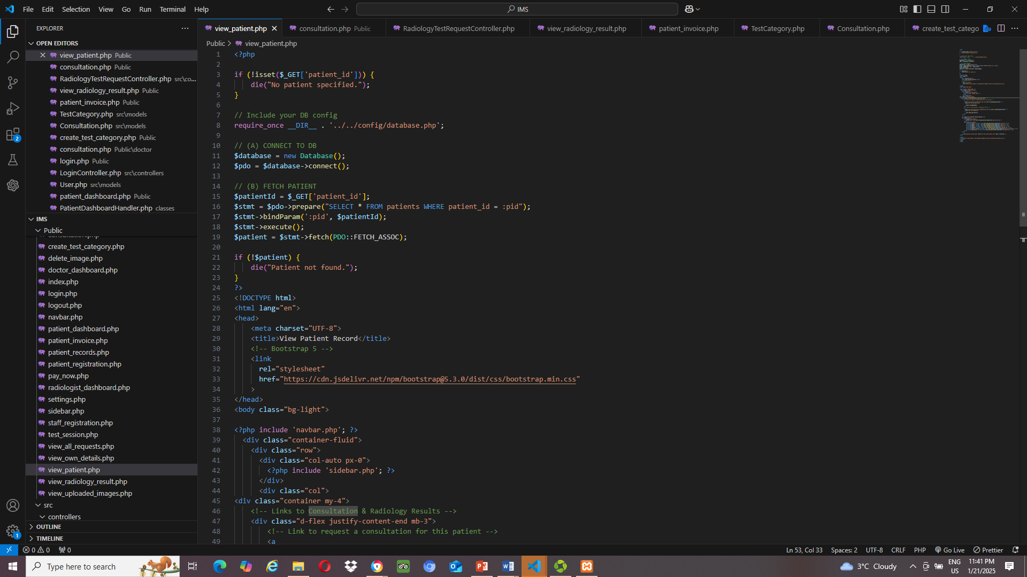
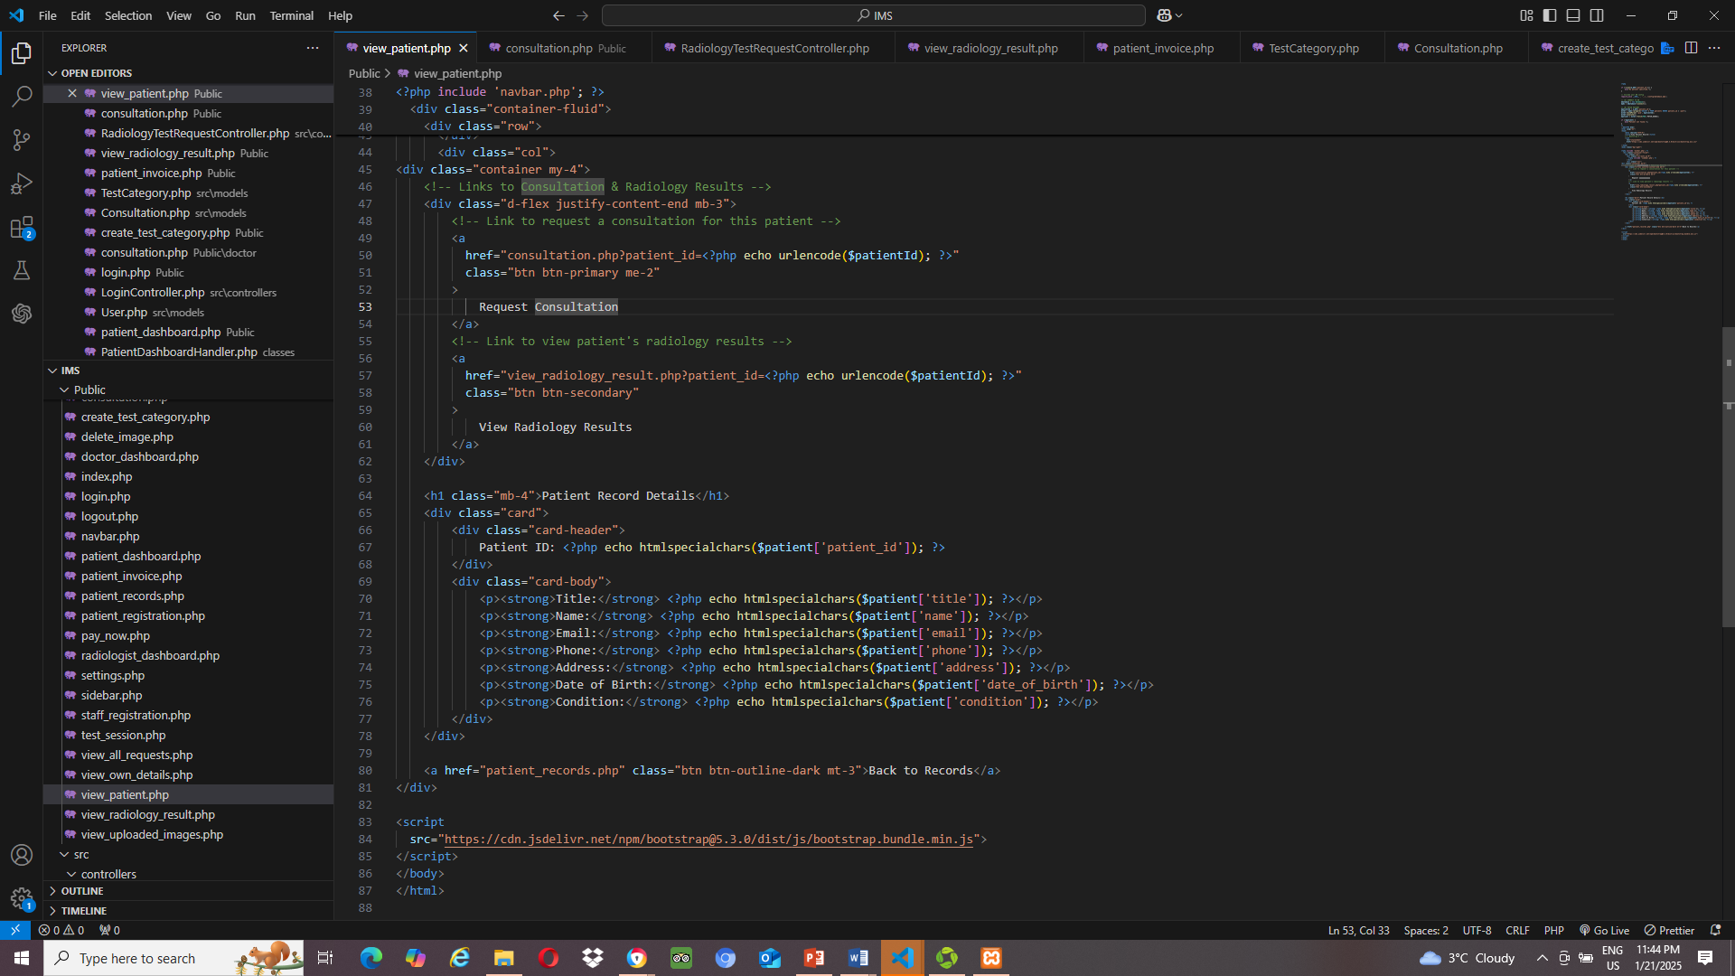
View_patient.php

Slide 32
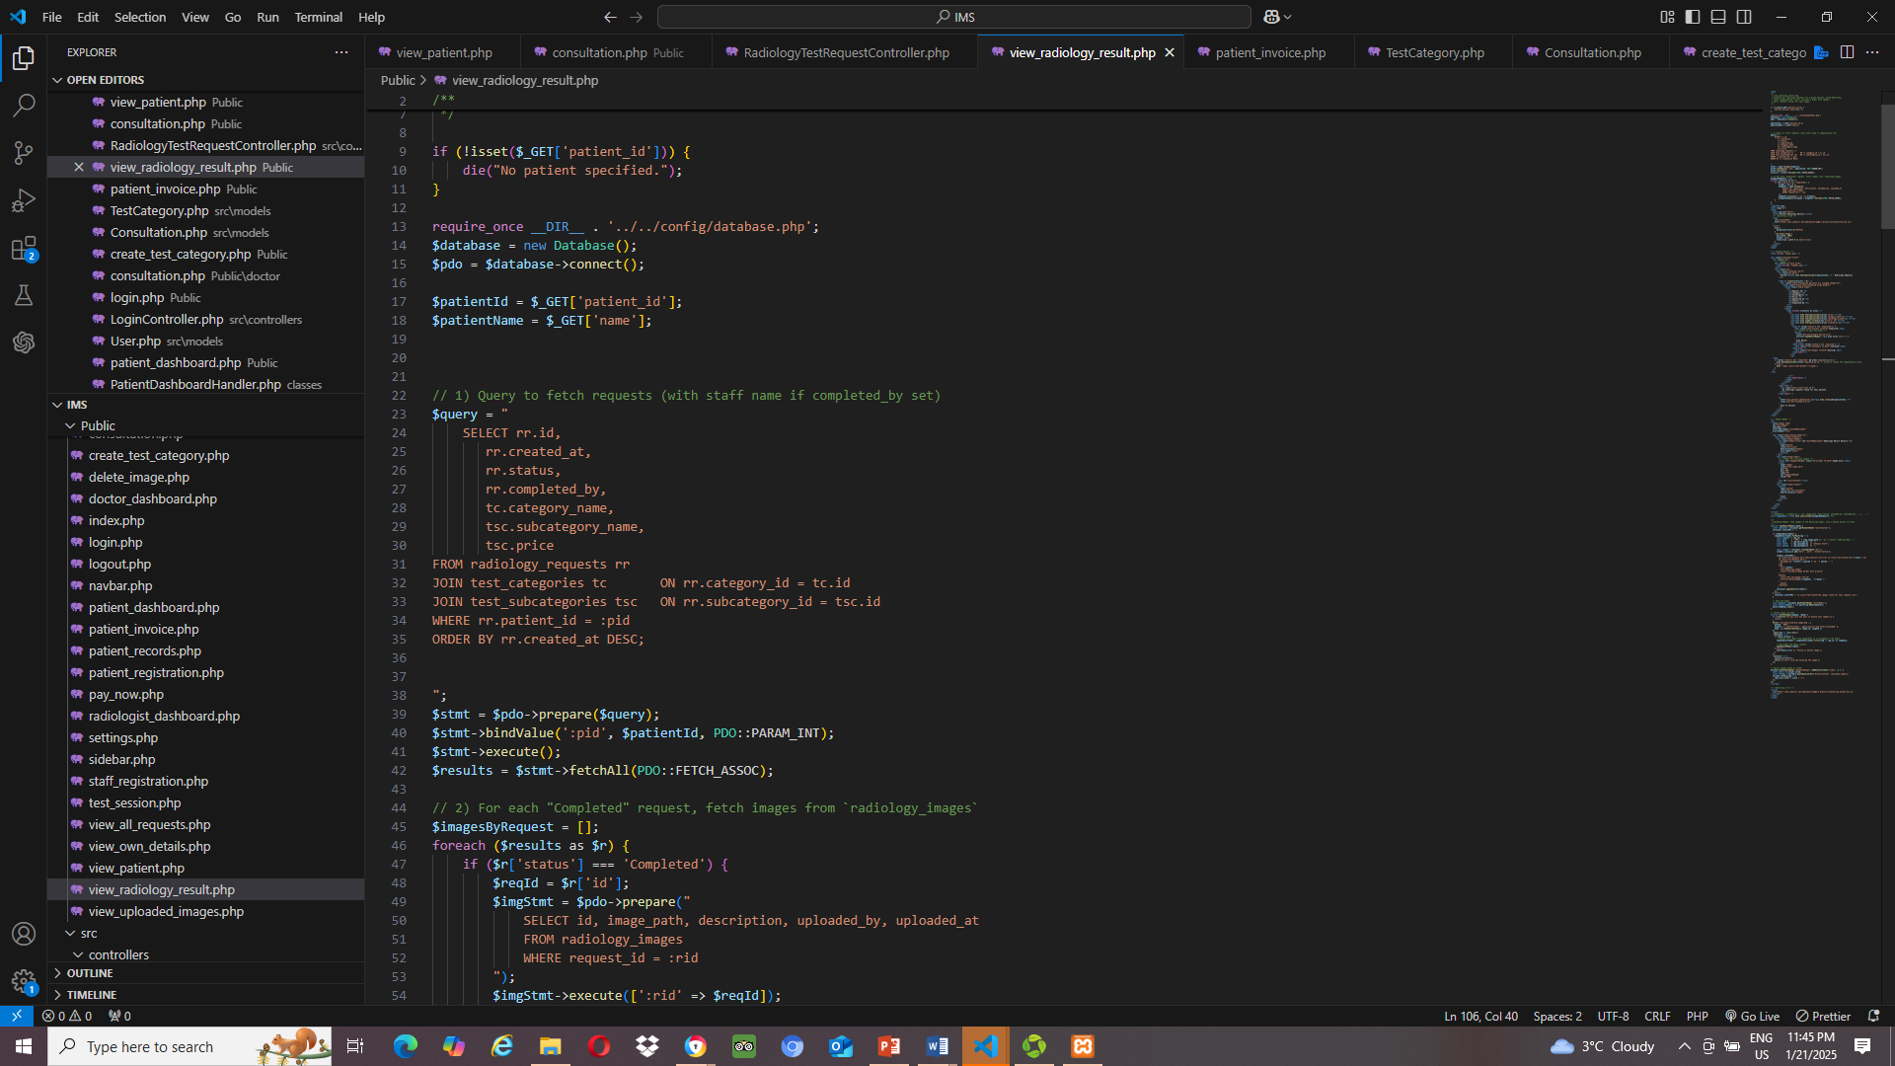
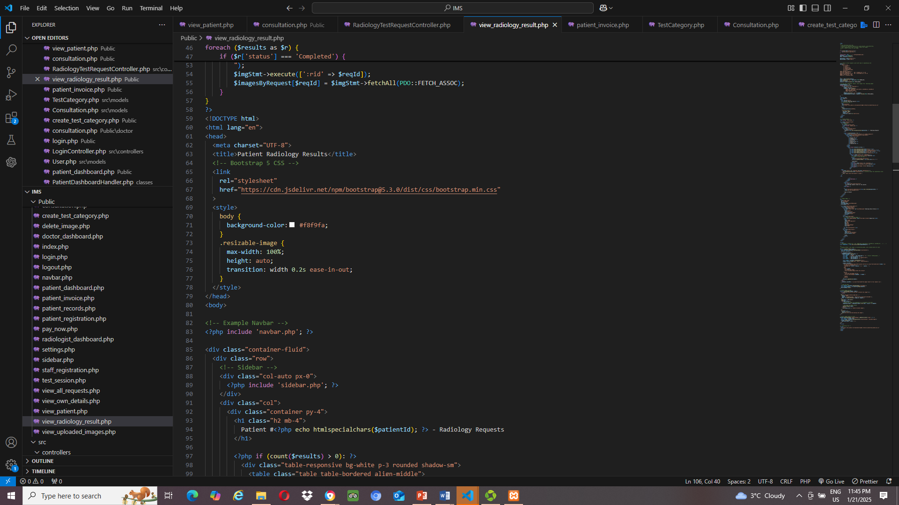
View_radiology_result.php

Slide 33
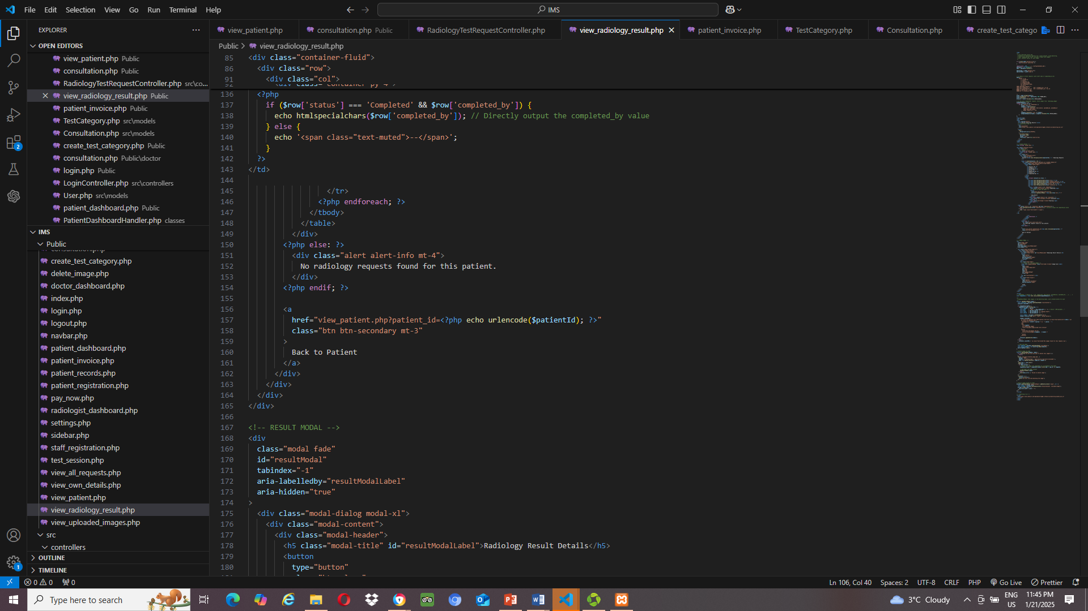
View_radiology_result.php

Slide 34
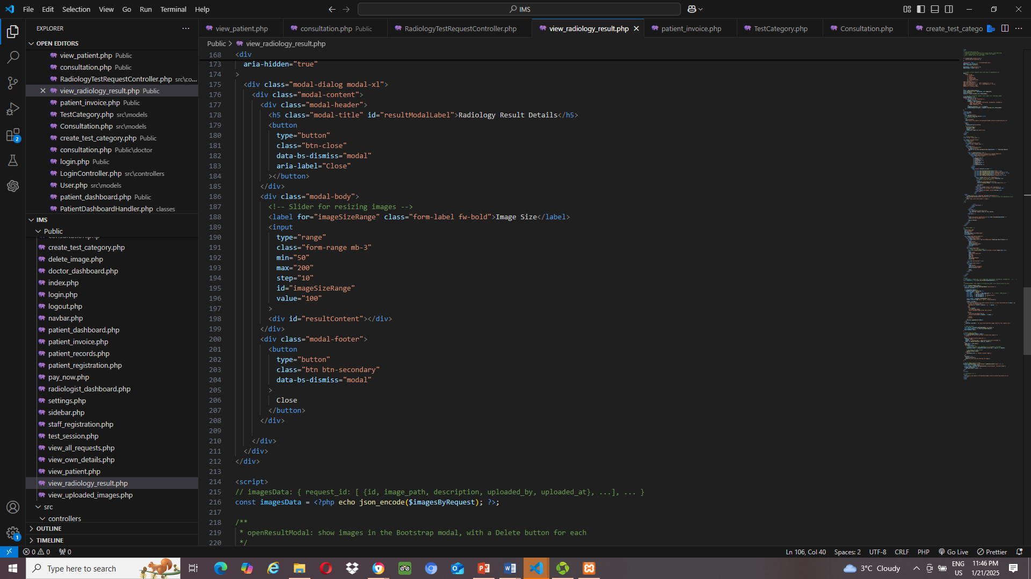
View_radiology_result.php

Slide 35
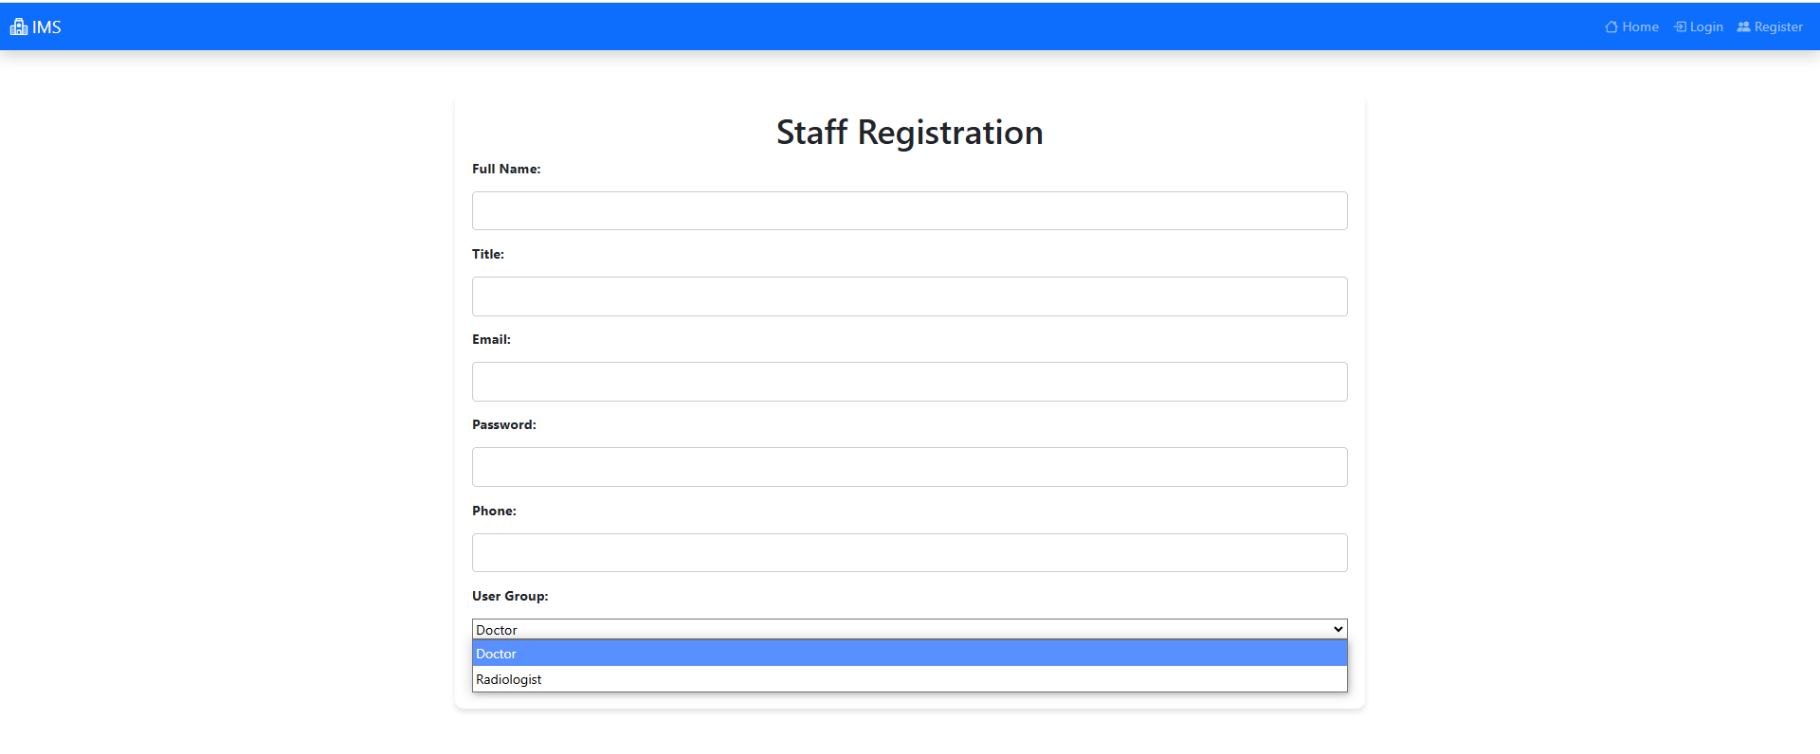
User Interface
Medical Staff Registration

Slide 36
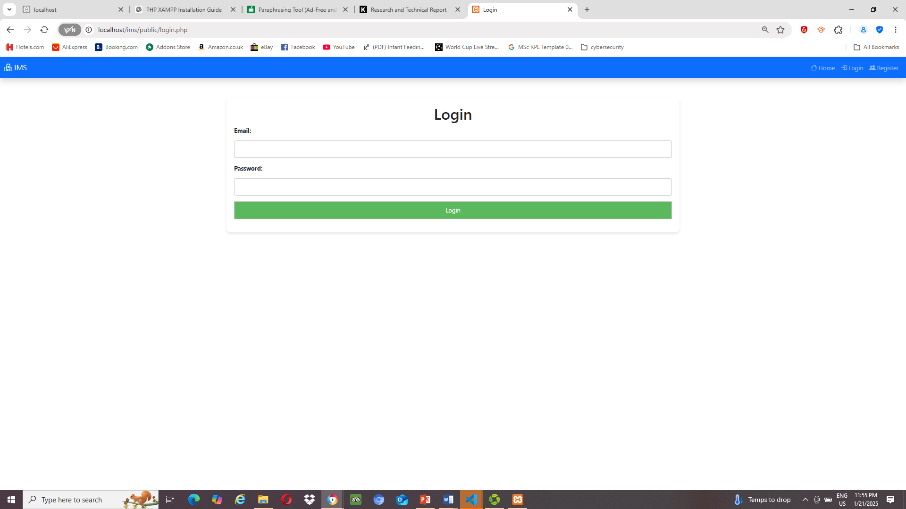
User Interface
Login

Slide 37
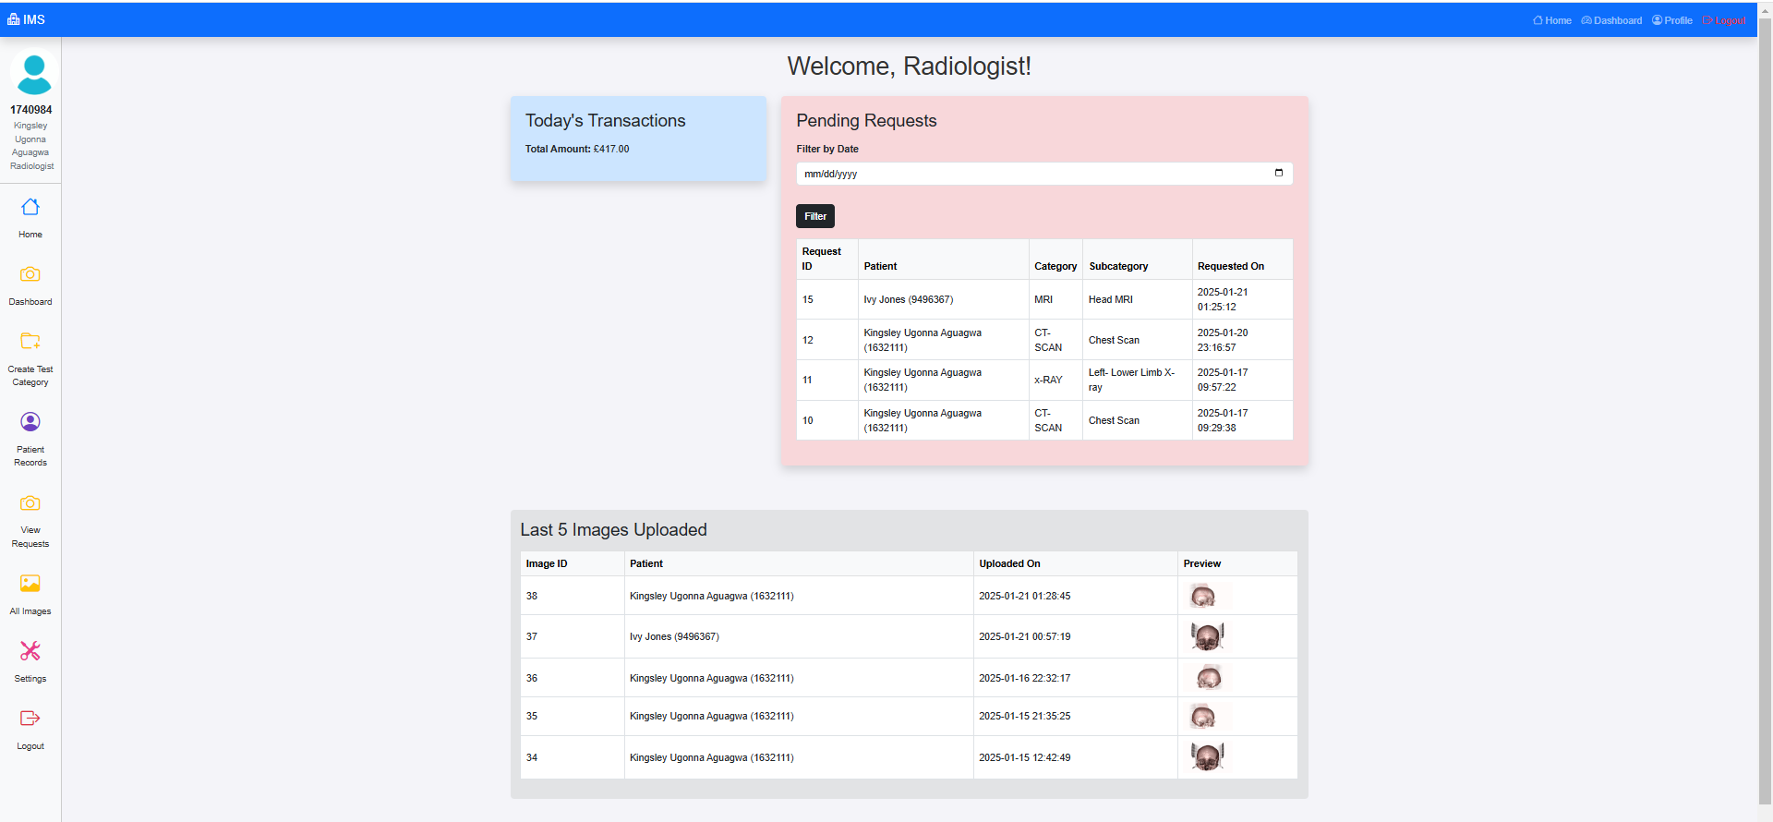
User Interface
Radiologist Dashboard

Slide 38
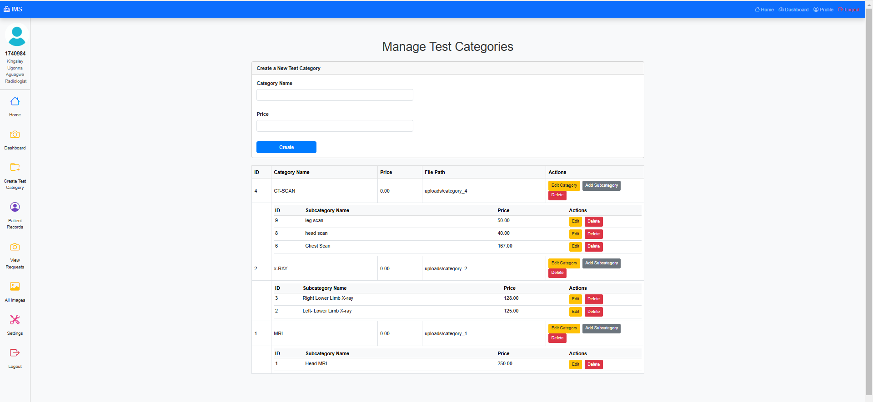
User Interface
Create Test Category

Slide 39

User Interface
Patient Record

Slide 40

User Interface
Patient Record Details

Slide 41

User Interface
Request Radiology Test

Slide 42


User Interface
Radiology Request Test
Radiology Result

Slide 43

User Interface
All Requested Test

Slide 44

User Interface
Upload Radiology images

Slide 45

User Interface
All Uploaded Images

Slide 46

User Interface
Settings to change website currency sign

Slide 47

User Interface
Patient Registration

Slide 48

User Interface
Patient Dashboard

Slide 49
User Interface
Patient Dashboard

Slide 50

User Interface
Patient Invoice

Slide 51

User Interface
Patient Payment Method

Slide 52

User Interface
Patient Profile

Slide 53

THANK YOU!
Kingsley Aguagwa
MSc Software Engineering with Management Studies
K2363903@Kingston.ac.uk

